Slide 1
Concurrency within the Computer System
Programming at the Hardware/Software Interface

Slide 2
This work is licensed under a Creative Commons Attribution 4.0 International License. This work is ©2018-21 Christopher A. Bohn, bohn@unl.edu.
You are free to:
Share — copy and redistribute the material in any medium or format
Adapt — remix, transform, and build upon the material for any purpose, even commercially
Under the following terms:
Attribution — You must give appropriate credit, provide a link to the license, and indicate if changes were made. You may do so in any reasonable manner, but not in any way that suggests the licensor endorses you or your use.
No additional restrictions — You may not apply legal terms or technological measures that legally restrict others from doing anything the license permits.
Slide by Bohn
These lecture slides are meant to enhance your use of the Programming at the Hardware/Software Interface textbook. If you have not adopted this publication for your course, please consider doing so.

Slide 3
Accessing I/O Devices with C
Memory-Mapped I/O

Slide 4
Direct I/O, aka Port-Mapped I/O
Typical
in dest, src out src, dest
Copies value from I/O port to memory or general-purpose register
Copies value from memory or general-purpose register to I/O port
I/O address space distinct from memory address space
Requires additional instructions
Less logic needed to decode address
C must use assembly-code libraries
Slide by Bohn

Slide 5
Memory-Mapped I/O
I/O device registers reside in memory address space
Any instruction that can use memory can access I/O register
No special instructions needed
Extra complexity in memory bus design
Simplified programming model
In C, a pointer can point to I/O device register
Slide by Bohn
Notes:
A pointer can point to an I/O device register because it’s “just” another address.
If it’s an input register, we’ll want to use the keyword volatile so the compiler doesn’t assume the register’s contents never change (don’t mis-optimize)

Slide 6
Designs can gravitate to Memory-Mapped I/O
Not a new concept – used in PDP-7
Motorola 68K used memory-mapped I/O exclusively
ATmega368P (used in Arduino Nano) has both direct-mapped I/O and memory-mapped I/O
AVR instruction set has 6-bit I/O address space
64 I/O ports wasn’t enough
Original I/O registers have both I/O addresses and memory addresses
Extended I/O registers only have memory addresses
RP2040 (used in Raspberry Pi Pico) has only memory-mapped I/O
Slide by Bohn

Slide 7
ATmega368P Data Memory
2KB SRAM
0x08FF
0x0100
0x00FF
0x0060
0x005F
0x0020
0x001F
0x0000
160 Extended I/O Registers
Slide by Bohn
0x3F
0x00
64 I/O Registers
I/O Address
Memory Address
32 General-Purpose Registers
Notes:
Surprisingly, even the general-purpose registers are memory-mapped!

Slide 8
RP2040 Memory
0xEFFF’FFFF
0xE000’0000
0xDFFF’FFFF
0xD000’0000
0x5FFF’FFFF
0x4000’0000
0x3FFF’FFFF
0x2000’0000
0x1FFF’FFFF
0x1000’0000
0x0FFF’FFFF
0x0000’0000
Cortex-M0+ Internal Registers
I/O Port Registers
Peripheral Registers
Memory Address
Full address space allocations aren’t used.
For example:
There is only 264 KB RAM, not 512MB
APB peripherals 0x4000’0000..0x4006’C000
AHB peripherals 0x5000’000..0x5040’0000
SIO registers 0xD000’0000..0xD000’017C
Internal Registers 0xE000’0000..0xE000’EDA0
SRAM
Slide by Bohn
Flash / XIP Cache
ROM
Notes:
What happens to the unused addresses?
In some cases, they’re mirrors of other memory addresses (the mirrors have different performance characteristics).
In other cases, they’re truly unused memory addresses, in which case, nothing good will come of dereferencing those unused addresses. (Perhaps nothing bad, either, but certainly nothing good.)

Slide 9
RP2040 Memory
Two 4KB SRAM Banks
Core 0 Stack
Core 1 Stack
Four 16KB SRAM Banks
Heap
SRAM
Slide by Bohn
.data & .bss
0x2000’0000
0x1000’0000
Vector Table
Flash / XIP Cache
2MB Flash (RPi Pico)
16MB Addressable (RP2040)
16KB Cache
Notes:
Cache memory is a topic for another day – but suffice it to say that instructions that are likely to be executed are copied into memory that’s faster to access than flash memory.

Slide 10
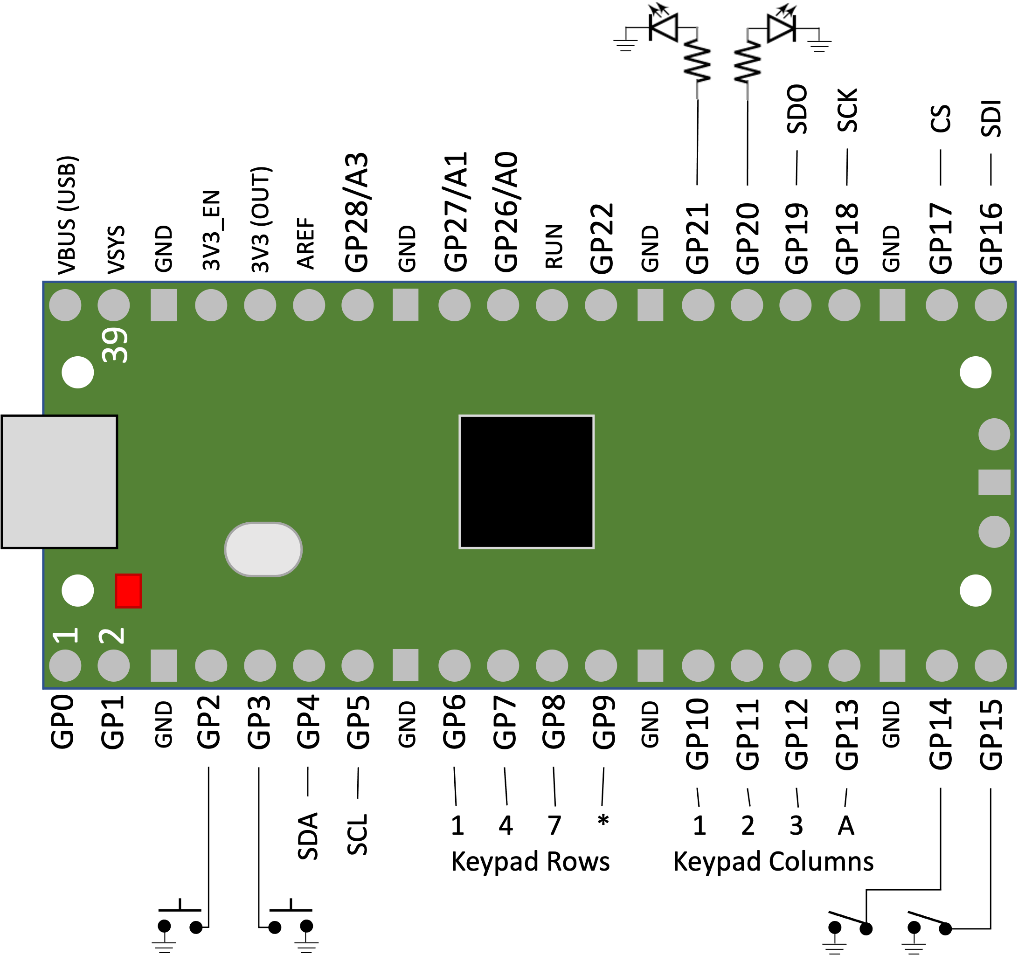
Let’s take a look at Raspberry Pi Pico
One set of I/O registers for all general-purpose pins
Other registers for special uses: ADC, SPI, I²C, UART
Registers
GPIO_IN
GPIO_OUT
GPIO_OE (“output enable”)
Atomic OUT, OE registers
Each pin independently set as input/output
Slide by Bohn
Notes:
Atomic registers GPIO_OUT_SET/GPIO_OUT_CLR/CPIO_OUT_XOR (and their “OE” counterparts) are needed for concurrent programs (i.e., using both M0+ cores.)
We’re only going to use one core, so we’ll use the read/modify/write pattern since that’s more broadly used.

Slide 11
Pins Can be Input or Output
Use Output Enable Register to set pin as input or output
Input pins can be
high impedance
pulled up
pulled down
High Impedance (Hi-Z) – logic level follows external input
Common with powered input devices
Pull Up – normally high; becomes low only when external input is low
Common with switches/buttons
Pull Down – normally low; becomes high only when external input is high
Not common
Slide by Bohn
Notes:
Datasheets have a LOT of useful information on them!

Slide 12
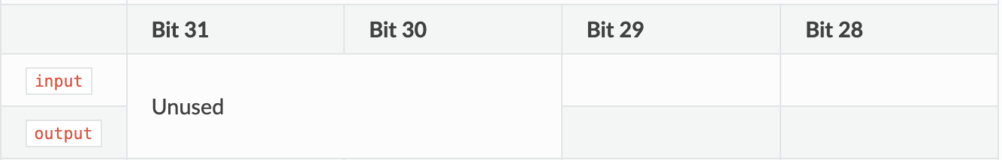
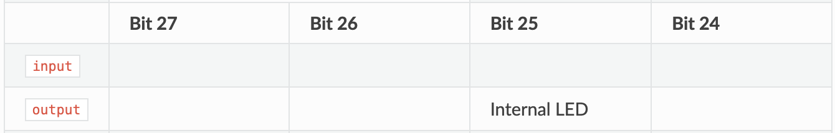
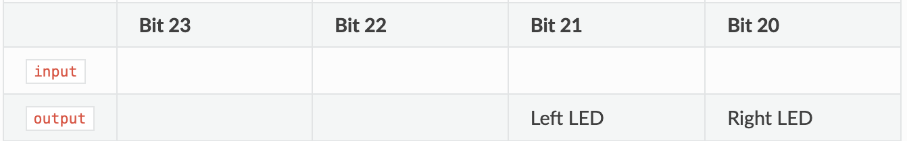
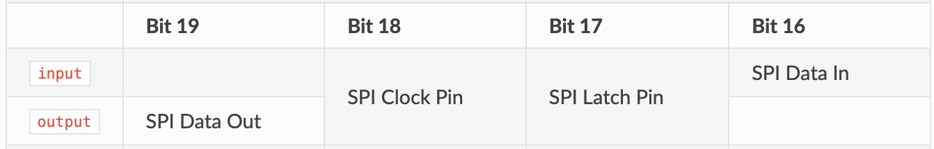
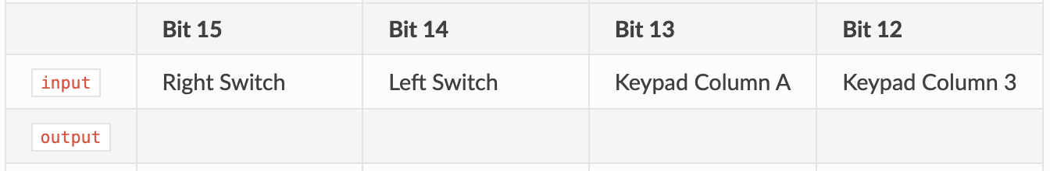
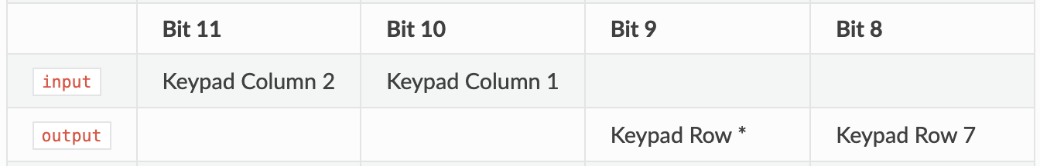
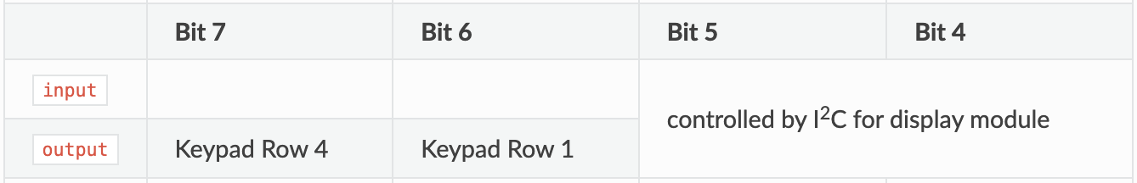
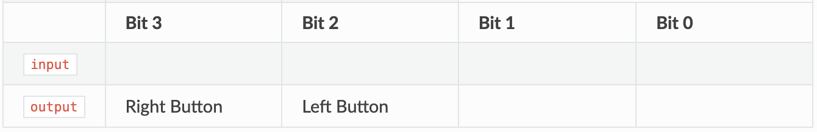
Input/Output Registers
0xD0000004
VSYS Measure
VBUS Sense
0xD0000010
Power Save
Slide by Bohn
Notes:
(click) Some parts of the I/O registers we want to leave alone – Good practice anyway to use bitmasks so you only affect the pins you want to affect, and CowPi isn’t using any of these pins.

Slide 13
Let’s take a look at Arduino Nano
PB4
PB3
PB2
PB1
PB0
PD7
PD6
PD4
PD3
PD2
PC6
PD0
PD5
PD1
D8
D9
D7
D6
D5
D4
D3
D2
D0 (RX)
D12
D11
D10
RESET
D1 (TX)
Three I/O ports (B,C,D)
Each port has three registers
PINx – Port x’s Input Register
DDRx – Port x’s Data Direction Register
PORTx – Port x’s Output Register
Each pin independently set as input/output
Slide by Bohn
D14/A0
D17/A3
D19/A5
D16/A2
D18/A4
A6
A7
D13
D15/A1
RESET
PB5
PC0
PC4
PC1
PC2
PC3
PC5
PC6

Slide 14
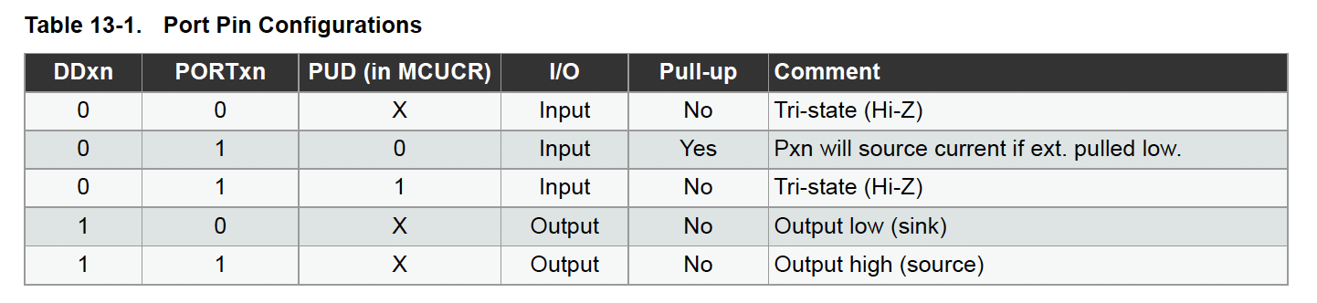
Pins Can be Input or Output
Use Data Direction Register to set pin as input or output
Default: input
Input pins can be high impedance or pulled up
Default: high impedance
High Impedance (Hi-Z) – logic level follows external input
Common with peripheral input devices, double-throw switches
Pull Up – normally high; becomes low only when external input is low
Common with single-throw switches
Slide by Bohn
ATmega328 Datasheet: https://ww1.microchip.com/downloads/en/DeviceDoc/Atmel-7810-Automotive-Microcontrollers-ATmega328P_Datasheet.pdf
Notes:
Datasheets have a LOT of useful information on them!

Slide 15
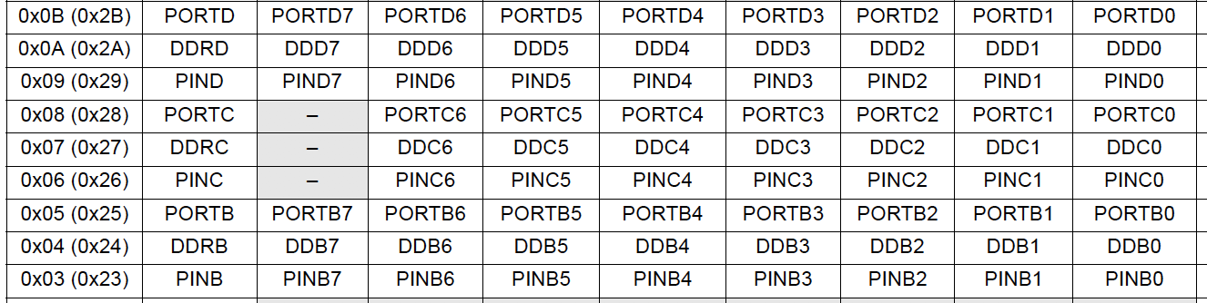
Input/Output Registers
UART Transmit/Receive
RESET
Slide by Bohn
Oscillator Inputs
ATmega328 Datasheet: https://ww1.microchip.com/downloads/en/DeviceDoc/Atmel-7810-Automotive-Microcontrollers-ATmega328P_Datasheet.pdf
Notes:
(click) Some parts of the I/O registers we want to leave alone – Good practice anyway to use bitmasks so you only affect the pins you want to affect, and CowPi isn’t using any of these pins.

Slide 16
System Libraries Abstract-Away These Details
Makes it very easy to program
No need to think about I/O registers
Very readable code
Makes code portable to devices with different microcontrollers
ATmega2560, ARM Cortex-M3, etc
We won’t use these abstractions
yet
Slide by Bohn

Slide 17
Accessing I/O Registers
typedef struct {
uint32_t cpu_id;
uint32_t input; // GPIO_IN
uint32_t :32; // padding (QSPI input)
uint32_t :32; // padding (not described)
uint32_t output; // GPIO_OUT
…
} cowpi_ioport_t;
cowpi_ioport_t volatile *gpio = (cowpi_ioport_t *)(0xD0000000);
Slide by Bohn
Notes:
“volatile” – prohibits compiler from optimizing-away reads & writes – tells the compiler there is more going on than what it can see; there is something else that can cause the values to change; there is something else that will read the values

Slide 18
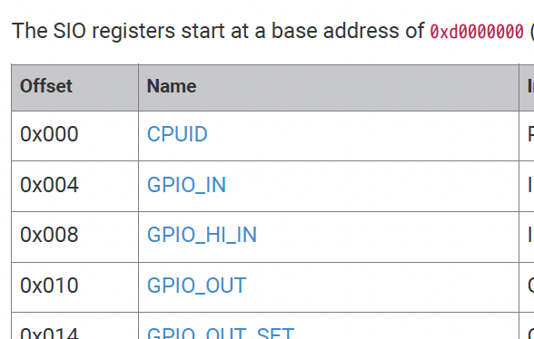
Accessing I/O Registers
typedef struct {
uint32_t cpu_id;
uint32_t input; // GPIO_IN
uint32_t :32; // padding (QSPI input)
uint32_t :32; // padding (not described)
uint32_t output; // GPIO_OUT
…
} cowpi_ioport_t;
cowpi_ioport_t volatile *gpio = (cowpi_ioport_t *)(0xD0000000);
Slide by Bohn
Notes:
Screenshot from RP2040 datasheet

Slide 19
Accessing I/O Registers
Also available:
#define A0_A5 1
#define D8_D13 0 // PINB/DDRB/PORTB
#define D14_D19 1 // PINC/DDRC/PORTC
#define D0_D7 2 // PIND/DDRD/PORTD
typedef struct {
uint8_t input; // PINx
uint8_t direction; // DDRx
uint8_t output; // PORTx
} cowpi_ioport_t;
volatile cowpi_ioport_t *gpio = (cowpi_ioport_t *)(0x23);
Slide by Bohn

Slide 20
Accessing I/O Registers
#define D8_D13 0 // PINB/DDRB/PORTB
#define D14_D19 1 // PINC/DDRC/PORTC
#define D0_D7 2 // PIND/DDRD/PORTD
typedef struct {
uint8_t input; // PINx
uint8_t direction; // DDRx
uint8_t output; // PORTx
} cowpi_ioport_t;
volatile cowpi_ioport_t *gpio = (cowpi_ioport_t *)(0x23);
0x3F
0x00
I/O Registers
0x005F
0x0020
I/O Address
Memory Address
Slide by Bohn

Slide 21
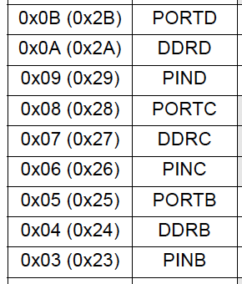
Accessing I/O Registers
#define D8_D13 0 // PINB/DDRB/PORTB
#define D14_D19 1 // PINC/DDRC/PORTC
#define D0_D7 2 // PIND/DDRD/PORTD
typedef struct {
uint8_t input; // PINx
uint8_t direction; // DDRx
uint8_t output; // PORTx
} cowpi_ioport_t;
volatile cowpi_ioport_t *gpio = (cowpi_ioport_t *)(0x23);
Slide by Bohn

Slide 22
Accessing I/O Registers
#define D8_D13 0 // PINB/DDRB/PORTB
#define D14_D19 1 // PINC/DDRC/PORTC
#define D0_D7 2 // PIND/DDRD/PORTD
typedef struct {
uint8_t input; // PINx
uint8_t direction; // DDRx
uint8_t output; // PORTx
} cowpi_ioport_t;
volatile cowpi_ioport_t *gpio = (cowpi_ioport_t *)(0x23);
Slide by Bohn

Slide 23
Accessing I/O Registers
#define D8_D13 0 // PINB/DDRB/PORTB
#define D14_D19 1 // PINC/DDRC/PORTC
#define D0_D7 2 // PIND/DDRD/PORTD
typedef struct {
uint8_t input; // PINx
uint8_t direction; // DDRx
uint8_t output; // PORTx
} cowpi_ioport_t;
volatile cowpi_ioport_t *gpio = (cowpi_ioport_t *)(0x23);
gpio[2]
gpio[D0_D7]
gpio[1]
Slide by Bohn
gpio[D14_D19]
gpio[0]
gpio[D8_D13]

Slide 24
Accessing I/O Registers
Reading from Input
Writing to Output
Treat it like any other variable in memory
foo = gpio->input;
Apply bitmask to read a specific bit (or bits)
foo = gpio->input & 0x00400000;
Use read-modify-write pattern to change only the intended bits
foo = gpio->output; foo = foo | 0x00400000; gpio->output = foo;
Or, as one line gpio->output &= ~0x00400000;
Sets GP22 to 1
Slide by Bohn
Sets GP22 to 0
Reads GP22

Slide 25
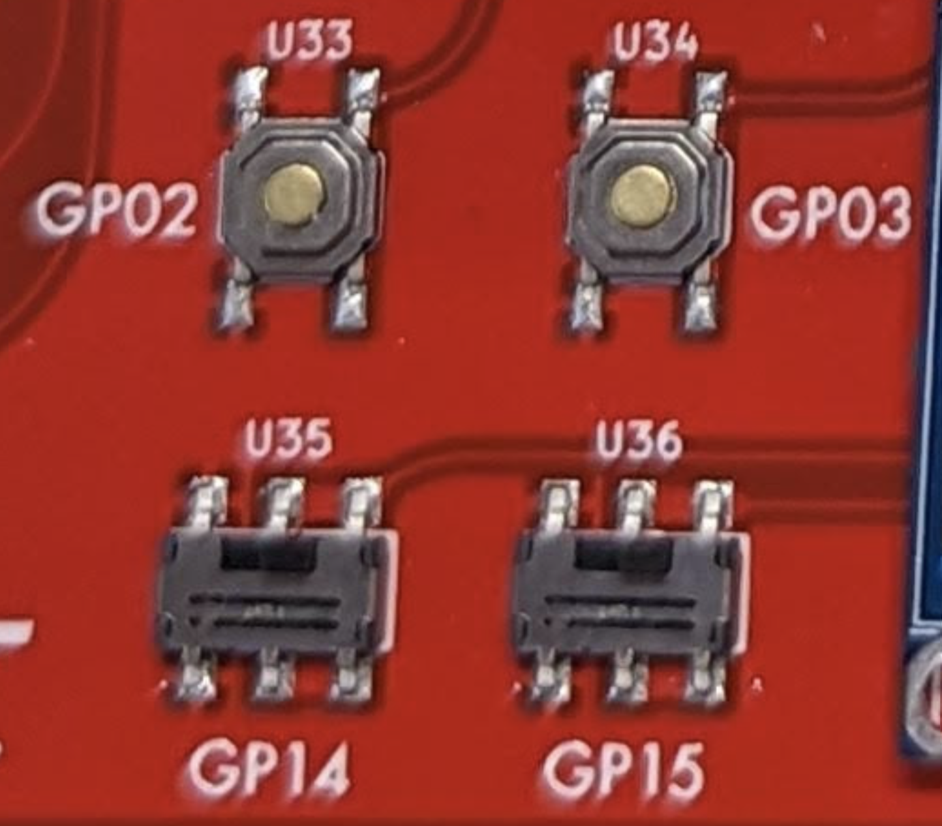
Cow Pi Inputs
SPDT switches
Set input Pull-Up
Left switch = GP14 input
Right switch = GP15 input
SPST momentary pushbuttons
Set input to Pull-Up
Left button = GP02 input
Right button = GP03 input
Slide by Bohn

Slide 26
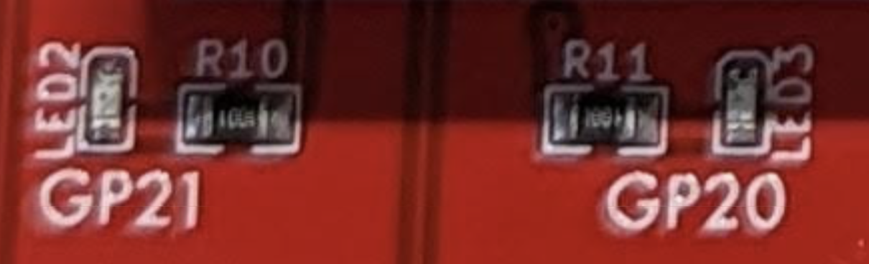
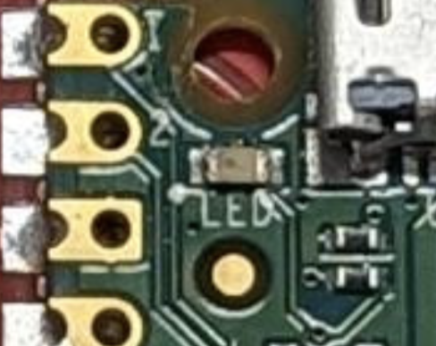
Cow Pi Outputs
Left LED = GP21 output
Right LED = GP20 output
Internal LED = GP25 output
Slide by Bohn

Slide 27
Using Input, Changing Output
void loop() {
uint32_t left_switch, right_switch, left_button, right_button;
left_switch = gpio->input & (1 << 14); // GP14
right_switch = gpio->input & (1 << 15); // GP15
left_button = gpio->input & (1 << 2); // GP02
right_button = gpio->input & (1 << 3); // GP03
if (left_button) { // button is not pressed
gpio->output &= ~(1 << 21); // turn LED at GP21 off
} else {
gpio->output |= (1 << 21); // turn LED at GP21 on
}
if (right_switch) {
gpio->output |= (1 << 20); // turn LED at GP20 on
} else {
gpio->output &= ~(1 << 20); // turn LED at GP20 off
}
}
Polling
Slide by Bohn
Notes:
Polling – periodically checking contents of register(s) – simple but requires system to be “always on”
Here, we’re retrieving a value before we act on it (textbook example retrieves value in the `if` condition; for the improved readability, we’re willing to accept the risk that the register changes in the fraction of a microsecond between reading the value and checking the value.

Slide 28
Input/Output Demonstration
Slide by Bohn

Slide 29
Accessing I/O Registers
Reading from Input
Writing to Output
Treat it like any other variable in memory
foo = gpio[D0_D7].input;
Apply bitmask to read a specific bit (or bits)
foo = gpio[D0_D7].input & 0x10;
Use read-modify-write pattern to change only the intended bits
foo = gpio[D0_D7].output; foo = foo | 0x10; gpio[DO_D7].output = foo;
Or, as one line gpio[DO_D7].output &= ~0x10;
Sets D4 to 1
Slide by Bohn
Sets D4 to 0
Reads D4

Slide 30
Accessing I/O Registers
Reading from Input
Writing to Output
Treat it like any other variable in memory
foo = gpio->input;
Apply bitmask to read a specific bit (or bits)
foo = gpio->input & 0x00400000;
Use read-modify-write pattern to change only the intended bits
foo = gpio->output; foo = foo | 0x00400000; gpio->output = foo;
Or, as one line gpio->output &= ~0x00400000;
Sets GP22 to 1
Slide by Bohn
Sets GP22 to 0
Reads GP22

Slide 31
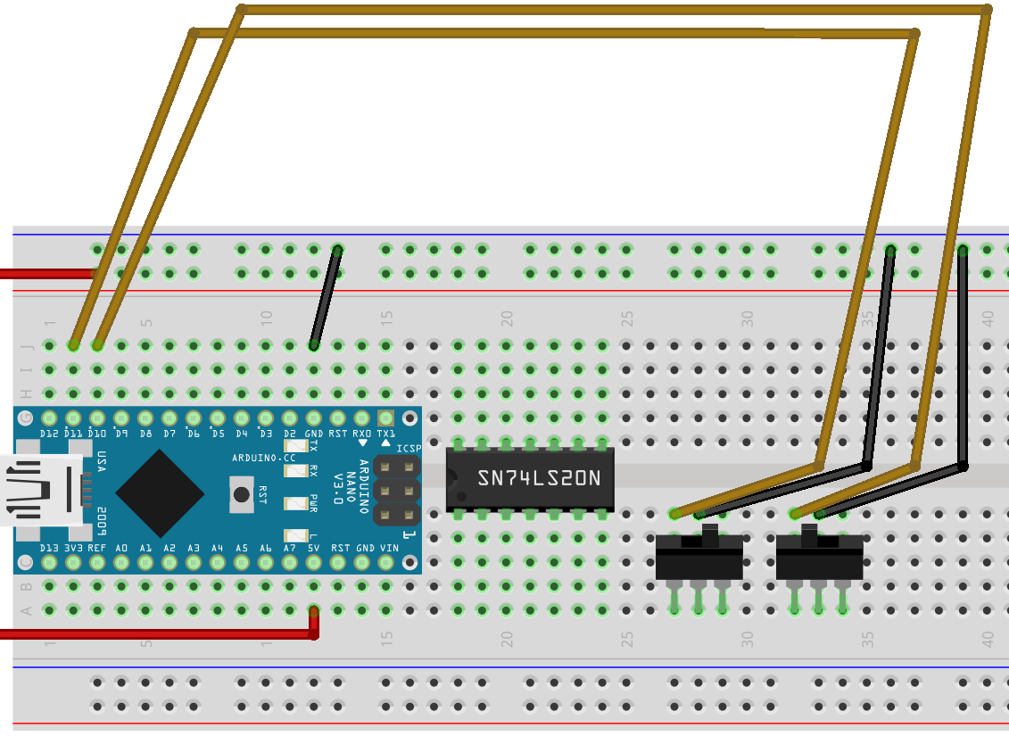
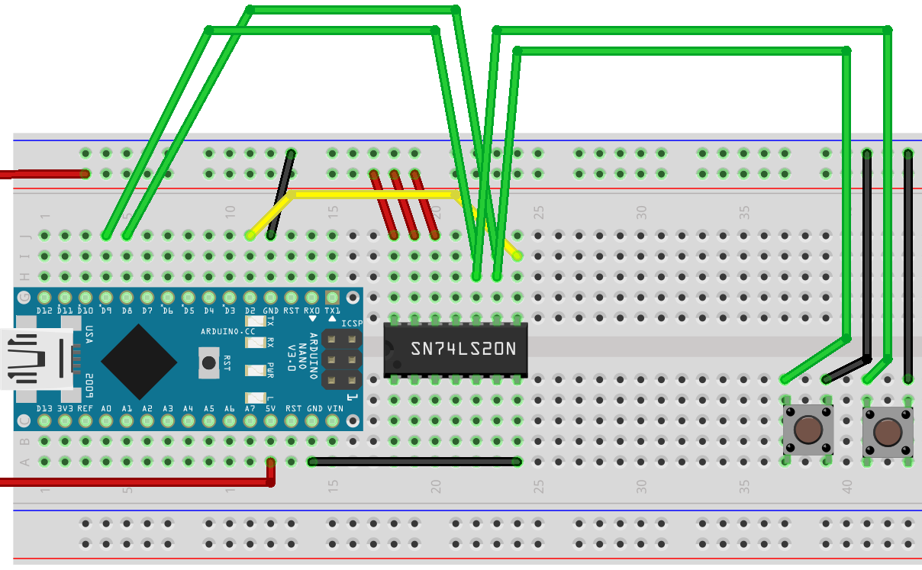
Cow Pi Inputs
SPDT switches
Set input Pull-Up
Left switch = D11 input
Right switch = D10 input
SPST momentary pushbuttons
Set input to Pull-Up
Left button = D8 input
Right button = D9 input
Slide by Bohn

Slide 32
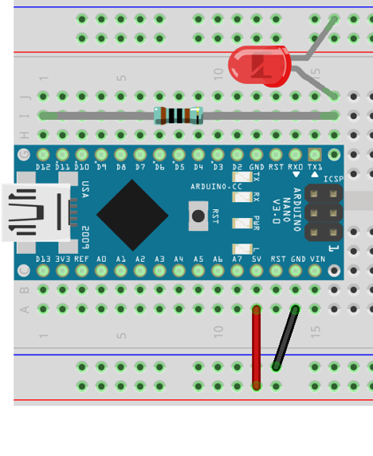
Cow Pi Outputs
External (“Right”) LED = D12 output
Built-in (“Left”) LED = D13 output
Slide by Bohn

Slide 33
Using Input, Changing Output
uint8_t left_switch, right_switch, left_button, right_button;
void loop() {
left_switch = gpio[D14_D19].input & (1 << 4); // D18 (A4)
right_switch = gpio[D14_D19].input & (1 << 5); // D19 (A5)
left_button = gpio[D8_D13].input & 1; // D8
right_button = gpio[D8_D13].input & (1 << 1); // D9
if (left_button) { // button is not pressed
gpio[D8_D13].output &= ~(1 << 4); // turn LED at D12 off
} else {
gpio[D8_D13].output |= (1 << 4); // turn LED at D12 on
}
if (right_switch) {
gpio[D8_D13].output |= (1 << 5); // turn LED at D13 on
} else {
gpio[D8_D13].output &= ~(1 << 5); // turn LED at D13 off
}
}
Polling
Slide by Bohn
Notes:
THIS SLIDE HAS THE SWITCH CONNECTIONS WHEN USING SPI
Polling – periodically checking contents of register(s) – simple but requires system to be “always on”
Here, we’re retrieving a value before we act on it (textbook example retrieves value in the `if` condition; for the improved readability, we’re willing to accept the risk that the register changes in the fraction of a microsecond between reading the value and checking the value.

Slide 34
Using Input, Changing Output
uint8_t left_switch, right_switch, left_button, right_button;
void loop() {
left_switch = gpio[D8_D13].input & (1 << 3); // D11
right_switch = gpio[D8_D13].input & (1 << 2); // D10
left_button = gpio[D8_D13].input & 1; // D8
right_button = gpio[D8_D13].input & (1 << 1); // D9
if (left_button) { // button is not pressed
gpio[D8_D13].output &= ~(1 << 5); // turn LED at D13 off
} else {
gpio[D8_D13].output |= (1 << 5); // turn LED at D13 on
}
if (right_switch) {
gpio[D8_D13].output |= (1 << 4); // turn LED at D12 on
} else {
gpio[D8_D13].output &= ~(1 << 4); // turn LED at D12 off
}
}
(1 << (11-8))
Polling
Slide by Bohn
Notes:
THIS SLIDE HAS THE SWITCH CONNECTIONS WHEN USING I2C
Polling – periodically checking contents of register(s) – simple but requires system to be “always on”
Here, we’re retrieving a value before we act on it (textbook example retrieves value in the `if` condition; for the improved readability, we’re willing to accept the risk that the register changes in the fraction of a microsecond between reading the value and checking the value.

Slide 35
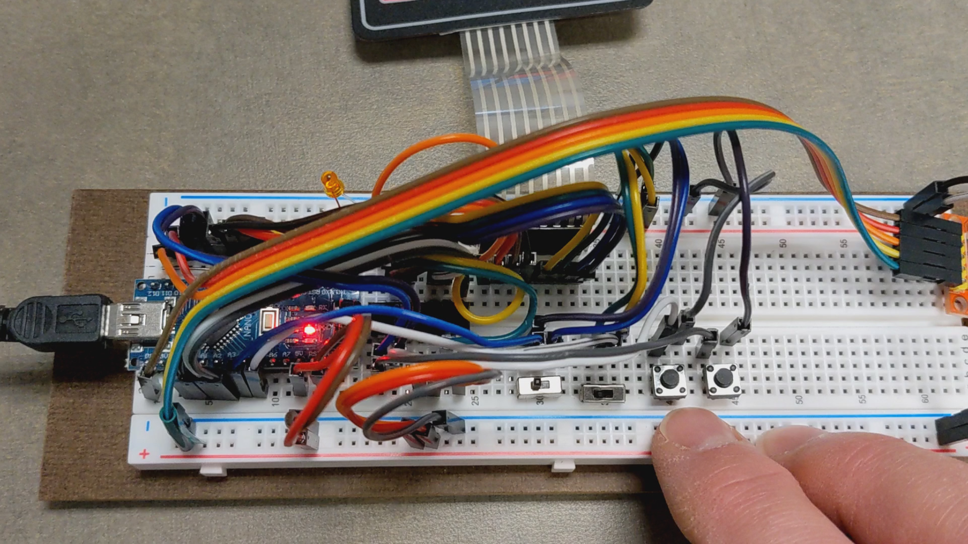
Input/Output Demonstration
Slide by Bohn

Slide 36
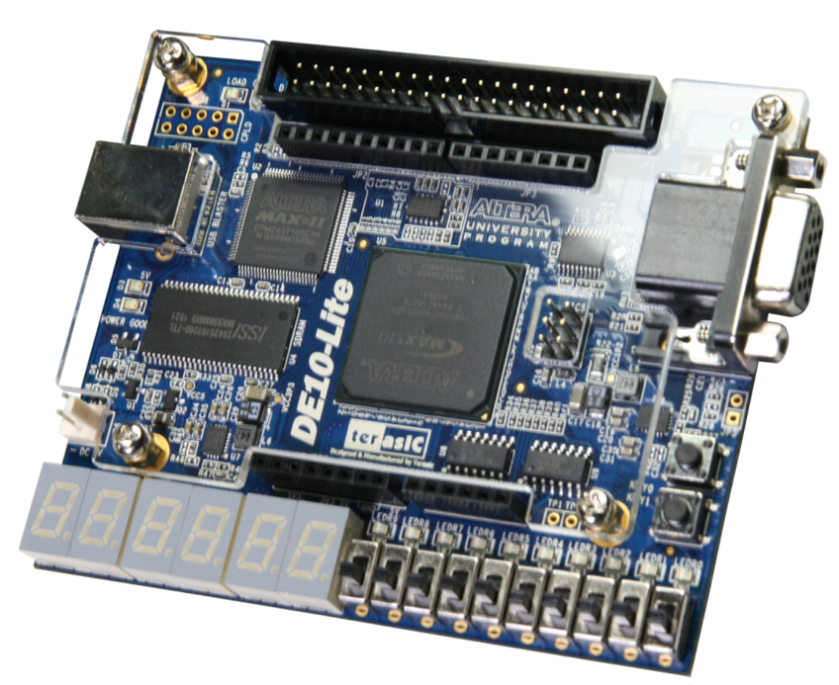
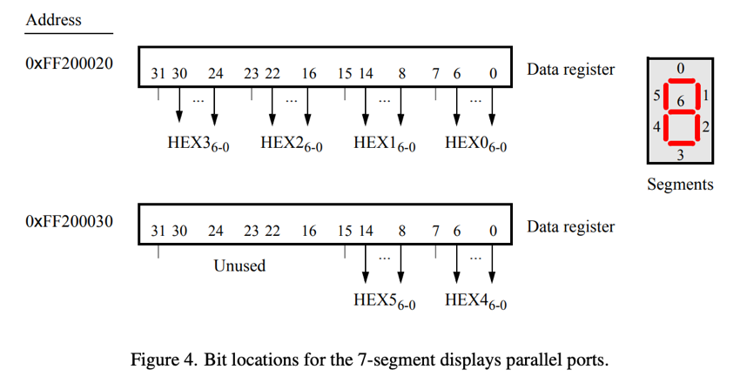
Other Memory-Mapped Inputs/Outputs Numeric Displays
Slide by Bohn
DE10-Lite Datasheet: https://ftp.intel.com/Public/Pub/fpgaup/pub/Intel_Material/18.1/Computer_Systems/DE10-Lite/DE10-Lite_Computer_NiosII.pdf
Notes:
DE10-Lite has 7-segment displays directly mapped to memory

Slide 37
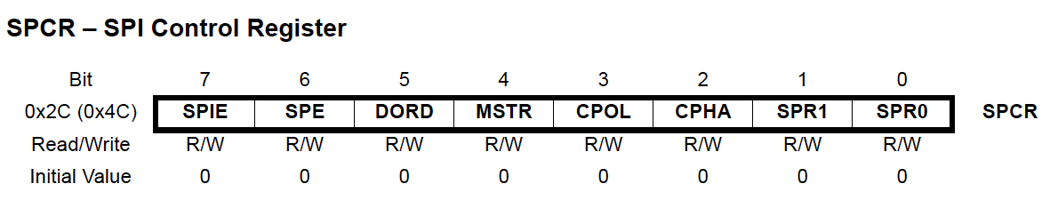
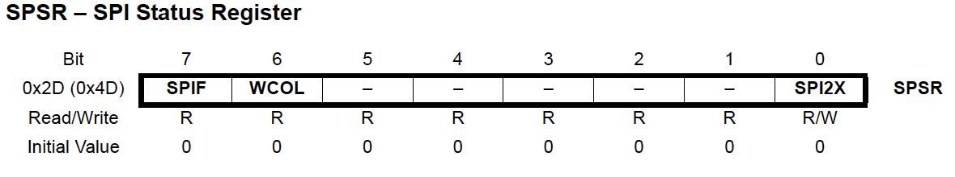
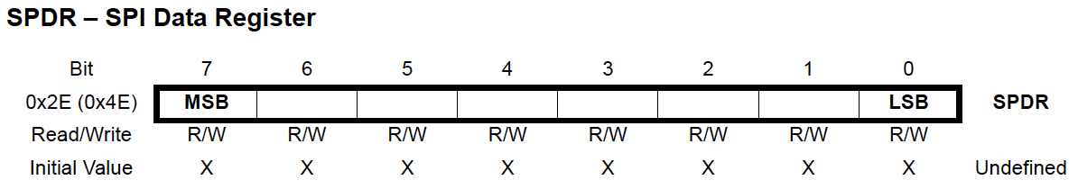
Other Memory-Mapped Inputs/Outputs Numeric Displays
Slide by Bohn
ATmega328 Datasheet: https://ww1.microchip.com/downloads/en/DeviceDoc/Atmel-7810-Automotive-Microcontrollers-ATmega328P_Datasheet.pdf
Notes:
Cow Pi mk1e uses SPI protocol for 7-segment displays

Slide 38
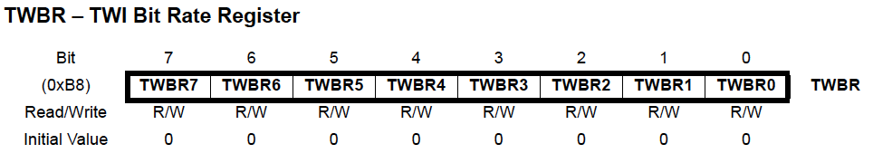
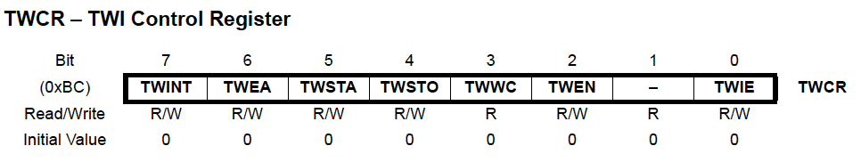
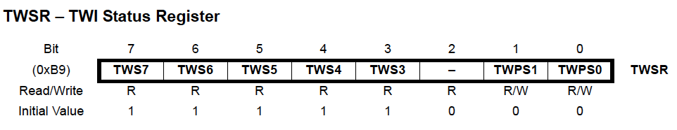
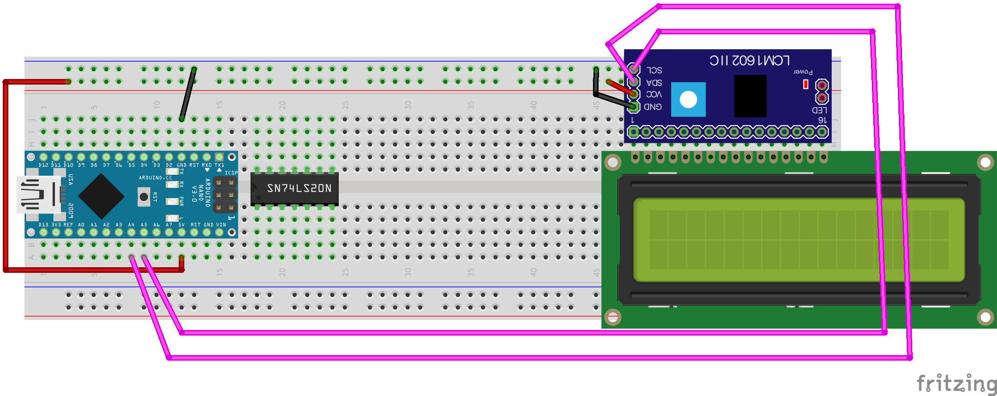
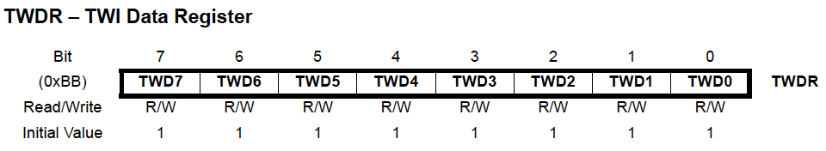
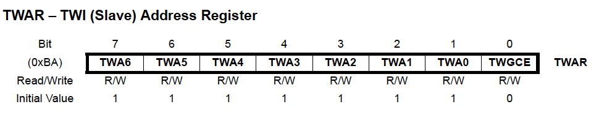
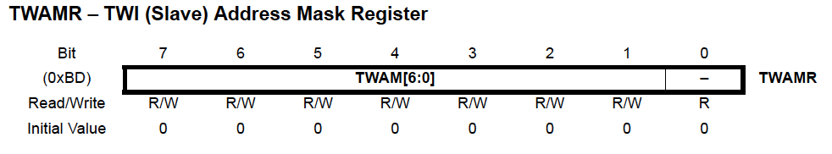
Other Memory-Mapped Inputs/Outputs Character Displays
Slide by Bohn
ATmega328 Datasheet: https://ww1.microchip.com/downloads/en/DeviceDoc/Atmel-7810-Automotive-Microcontrollers-ATmega328P_Datasheet.pdf
Notes:
Cow Pi mk1f uses I2C protocol for 16x2 LCD character display

Slide 39
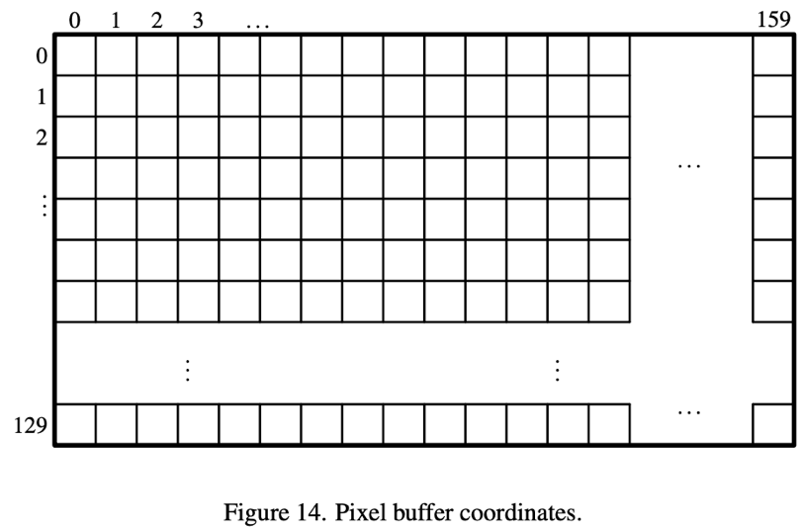
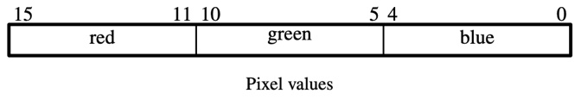
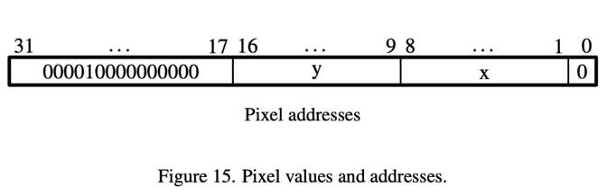
Other Memory-Mapped Inputs/Outputs VGA Pixel Buffer
Slide by Bohn
DE10-Lite Datasheet: https://ftp.intel.com/Public/Pub/fpgaup/pub/Intel_Material/18.1/Computer_Systems/DE10-Lite/DE10-Lite_Computer_NiosII.pdf
Notes:
I’m pretty sure the y-axis is supposed to be 0..119, not 0..129 since the documentation says the buffer is 160x120.
Some good review of earlier material:
Notice that the pixel buffer is stored in row-major order (see pixel addresses).
Notice that each row occupies 256 elements (really 512 because of that trailing 0) instead of 160 elements. Why? Because we can determine a row’s base address much faster by shifting by 9 than by multiplying by 320.
Might be useful to practice concatenating bitfields – the 8-bit ATmega328 used in the Arduino Nano really doesn’t afford much opportunity to do so, and it’s good to keep it “fresh” in students’ minds.

Slide 40
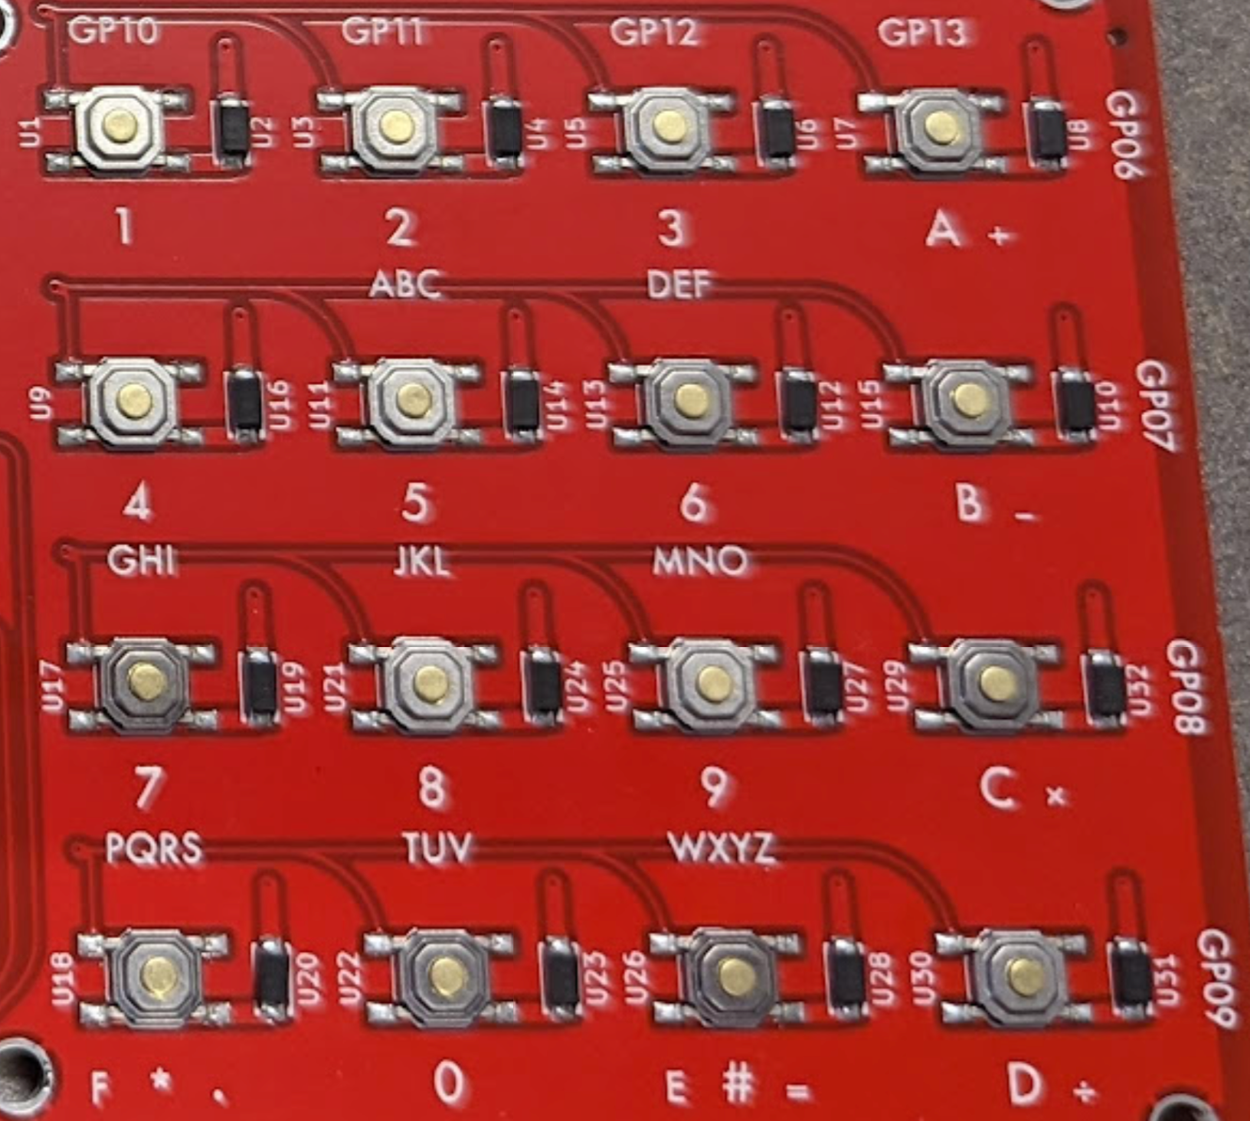
Other Memory-Mapped Inputs/Outputs Matrix Keypad
Decoding key presses requires combination of inputs and outputs (covered in lab)
Integrated Circuits exist to decode matrix keypads, deliver BCD input to systems
Slide by Bohn

Slide 41
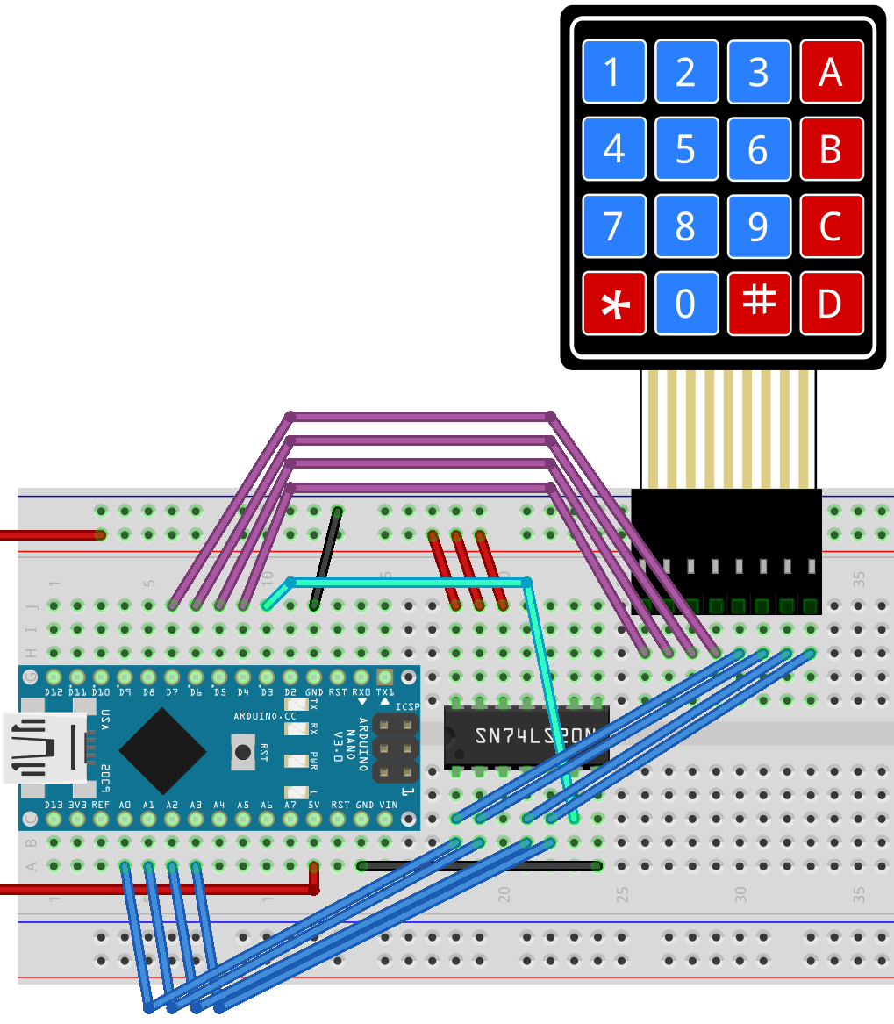
Other Memory-Mapped Inputs/Outputs Matrix Keypad
Decoding key presses requires combination of inputs and outputs (covered in lab)
Integrated Circuits exist to decode matrix keypads, deliver BCD input to systems
Slide by Bohn

Slide 42
Internal Timer
RP2040 has one general-purpose 64-bit timer
Increments once every microsecond
Also has real-time clock
We won’t use this
Slide by Bohn

Slide 43
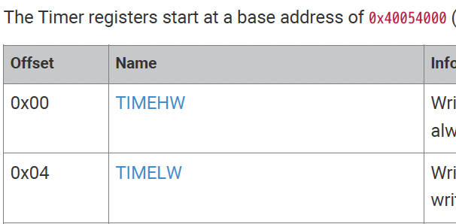
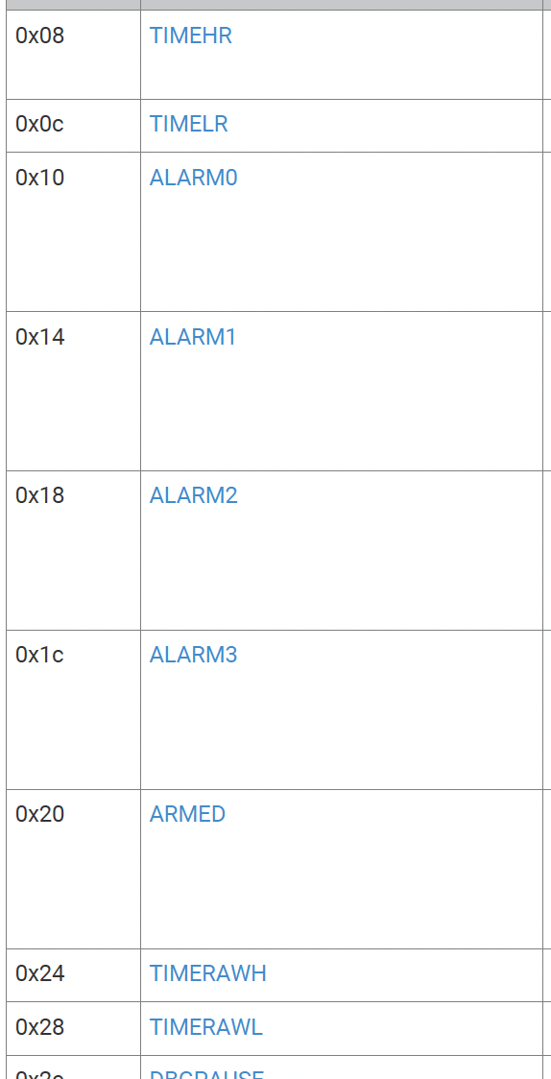
Timer Registers
typedef struct {
uint32_t :32;
uint32_t :32;
uint32_t upper_word; // 63..32
uint32_t lower_word; // 31..0
uint32_t alarms[4];
uint32_t alarm_status;
uint32_t raw_upper_word;
uint32_t raw_lower_word;
…
} cowpi_timer_t;
Slide by Bohn
Notes:
CowPi library does not support writing to timer registers

Slide 44
Timer Registers
typedef struct {
uint32_t :32;
uint32_t :32;
uint32_t upper_word; // 63..32
uint32_t lower_word; // 31..0
uint32_t alarms[4];
uint32_t alarm_status;
uint32_t raw_upper_word;
uint32_t raw_lower_word;
…
} cowpi_timer_t;
64-bit counter
32-bit memory bus
Race condition with possible inconsistency when lower_word overflows
Slide by Bohn

Slide 45
Timer Registers
Reading from lower_word latches the value of upper_word
Always read lower_word before upper_word
uint32_t counter_lower_word = timer->lower_word;
uint64_t counter = ((uint64_t)(timer->upper_word) << 32) | counter_lower_word;
Will overflow in 2⁶⁴µs = 584,542 years
Y586.5M problem?
typedef struct {
uint32_t :32;
uint32_t :32;
uint32_t upper_word; // 63..32
uint32_t lower_word; // 31..0
uint32_t alarms[4];
uint32_t alarm_status;
uint32_t raw_upper_word;
uint32_t raw_lower_word;
…
} cowpi_timer_t;
Slide by Bohn
Notes:
“Latches” – places a copy of the actual upper word into the upper_word register so that we can later read it without worrying about the value changing.

Slide 46
Timer Registers
If you can get by with a 32-bit counter, read from raw_lower_word
Doesn’t latch raw_pper_word
uint32_t counter_lower_word = timer->raw_lower_word;
Will overflow in 2³²µs = 71 minutes, 35 seconds
typedef struct {
uint32_t :32;
uint32_t :32;
uint32_t upper_word; // 63..32
uint32_t lower_word; // 31..0
uint32_t alarms[4];
uint32_t alarm_status;
uint32_t raw_upper_word;
uint32_t raw_lower_word;
…
} cowpi_timer_t;
Slide by Bohn
Notes:
Dad joke alert. Not Y2K, but Y today.

Slide 47
Internal Timer/Counters
ATmega328P has 3 timer/counters
Timer 0: 8 bit
Timer 1: 16 bit
Timer 2: 8 bit
Count from 0 to 0xFF/0xFFFF or to other specified value
Timers 0 & 1 use system clock (16MHz) as frequency source
Timer 2 uses system clock by default but can be changed
Use prescaler to count slower than 16MHz
Slide by Bohn

Slide 48
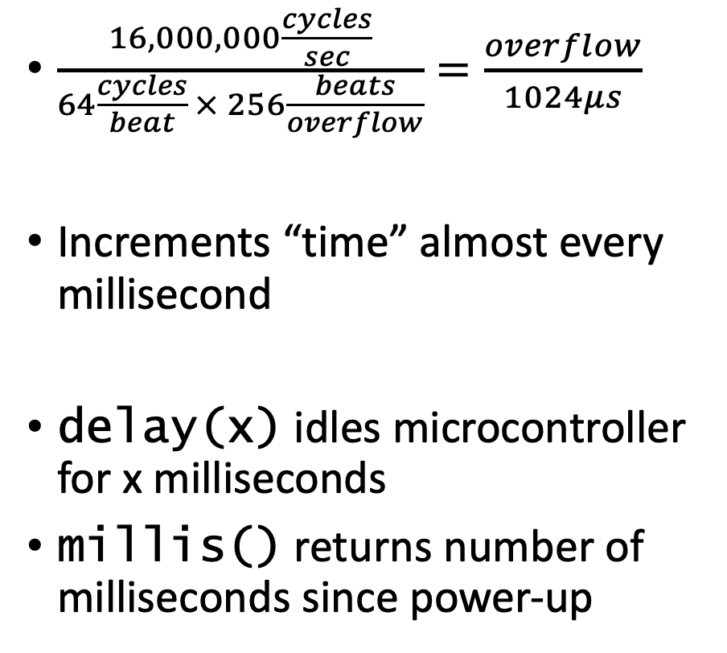
Internal Timer/Counters
$\frac{16,000,000\frac{cycles}{sec}}{64\frac{cycles}{beat} × 256\frac{beats}{overflow}}=\frac{overflow}{1024μs}$
Increments “time” almost every millisecond
delay(x) idles microcontroller for x milliseconds
millis() returns number of milliseconds since power-up
Timer 0 used for pseudo-real-time clock, counts number of milliseconds since power-up
Counter overflows every 256 beats
Prescaler=64
Slide by Bohn
Notes:
Because Timer 0 is used for pseudo-real-time clock, we probably don’t want to mess with it.
(Timers 1 & 2 also have application-specific uses, but the Cow Pi design excludes those applications)
Milliseconds uses uint32_t
There are also delayMicroseconds() and micros(), but I don’t think those’d be very useful for us

Slide 49
Internal Timer/Counters
// blink.ino
void setup() {
pinMode(LED_BUILTIN, OUTPUT);
}
void loop() {
digitalWrite(LED_BUILTIN, HIGH);
delay(1000);
digitalWrite(LED_BUILTIN, LOW);
delay(1000);
}
Can we make an LED blink the same rate as blink.ino without using delay()?
Slide by Bohn
Notes:
This is a blocking implementation – nothing else can happen during the delays

Slide 50
Internal Timer/Counters
void setup() {
pinMode(LED_BUILTIN, OUTPUT);
}
void loop() {
uint32_t time = millis();
if (time & 0x0400)
digitalWrite(LED_BUILTIN, HIGH);
else
digitalWrite(LED_BUILTIN, LOW);
}
Can we make an LED blink the same rate as blink.ino without using delay()?
Yes, by using millis() and a bitmask
Not exactly the same rate
Originally LED was lit for 1000“ms”
1.024 seconds
Now LED is lit for 1024“ms”
1.049 seconds
Can we do it with Timer 2?
Slide by Bohn
Notes:
This is a non-blocking implementation – we could have other code outside this if/else that would continue to run and update the system state

Slide 51
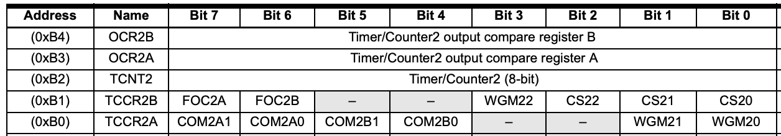
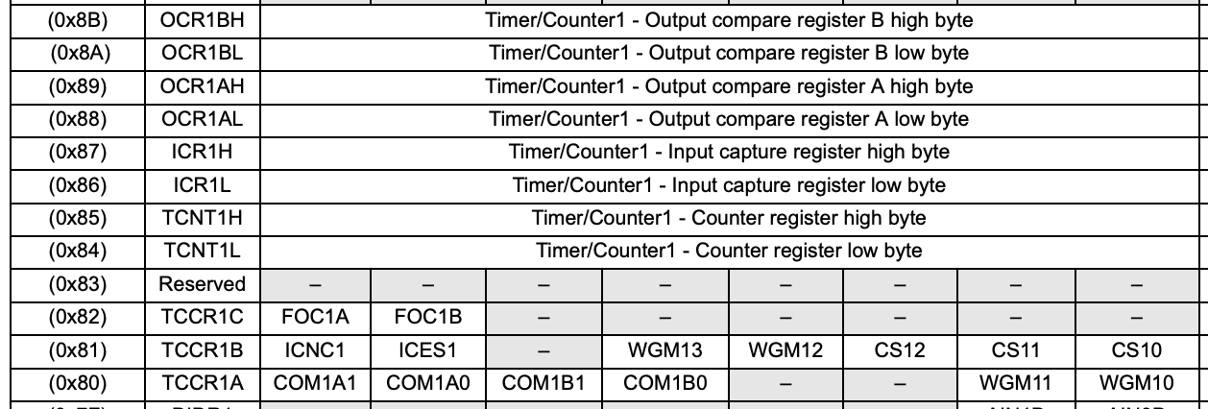
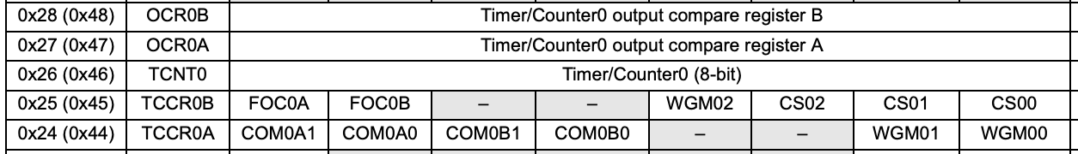
Timer Registers
Slide by Bohn
ATmega328 Datasheet: https://ww1.microchip.com/downloads/en/DeviceDoc/Atmel-7810-Automotive-Microcontrollers-ATmega328P_Datasheet.pdf
Notes:
For this example, we only need the 8-bit counters

Slide 52
Accessing Timer Registers
typedef struct {
uint16_t control; // TCCRxB TCCRxA
uint8_t counter; // TCNTx
uint8_t compareA; // OCRxA
uint8_t compareB; // OCRxB
} cowpi_timer8bit_t;
Volatile cowpi_timer8bit_t *mytimer0 = (cowpi_timer8bit_t *)(0x44);
Volatile cowpi_timer8bit_t *mytimer2 = (cowpi_timer8bit_t *)(0xB0);
Slide by Bohn

Slide 53
“Blink”
Can we make an LED blink the same rate as blink.ino without using Arduino functions?
void loop() {
digitalWrite(LED_BUILTIN, HIGH);
delay(1000);
digitalWrite(LED_BUILTIN, LOW);
delay(1000);
}
Slide by Bohn
Notes:
This is a blocking implementation – nothing else can happen during the delays

Slide 54
“Blink” using busy-wait
void loop() {
uint32_t then;
gpio->output |= ~(1 << 25);
then = timer->raw_lower_word;
while (timer->raw_lower_word < then + 1000000) {}
then = timer->raw_lower_word;
gpio->output &= ~(1 << 25);
while (then > timer->raw_lower_word - 1000000) {}
}
Race Condition!
Slide by Bohn
Race Condition!
Notes:
If (UINT32_MAX - 1000000 < then ≤ UINT32_MAX - 1) then (now) can be a large value and (then + 1000000) can be a small value, and the first busy-wait never executes.
If (then < 999998) then (now - 1000000) can be a large value and (then) can be a small value, and the second busy-wait never executes.

Slide 55
“Blink” using busy-wait
void loop() {
uint32_t then;
gpio->output |= ~(1 << 25);
then = timer->raw_lower_word;
while (timer->raw_lower_word - then < 1000000) {}
then = timer->raw_lower_word;
gpio->output &= ~(1 << 25);
while (timer->raw_lower_word - then < 1000000) {}
}
Slide by Bohn
Notes:
No race conditions here
Just one problem -- this is a blocking implementation – nothing else can happen during the busy-waits

Slide 56
“Blink” using busy-wait Demonstration
Slide by Bohn

Slide 57
Non-blocking “Blink”
void loop() {
static uint32_t last_change = 0;
static bool is_illuminated = false;
uint32_t now = timer->raw_lower_word;
if (now – last_change < 1000000) {
last_change = now;
is_illuminated = !is_illuminated;
if (is_illuminated) {
gpio->output |= (1 << 25);
} else {
gpio->output &= ~(1 << 25);
}
}
}
Slide by Bohn
Notes:
Our system is now responsive to user input, to within a few microseconds (which is effectively instantaneous on the human scale).
Thinking about the concurrency that we had to introduce into the chat server, that was because most functions are written to be blocking functions. “Dee” couldn’t connect while the server was blocked on a read() function waiting for “Stu” to enter his username.
Retrieving a value from memory, however, is non-blocking. Since user input (and timer input) is coming in the form of changes to the contents of memory-mapped registers, we can get the user input without blocking. This introduces a new challenge: our program is now responsible for determining when the user is providing input and when the user isn’t.

Slide 58
Non-blocking “Blink” Demonstration
Slide by Bohn

Slide 59
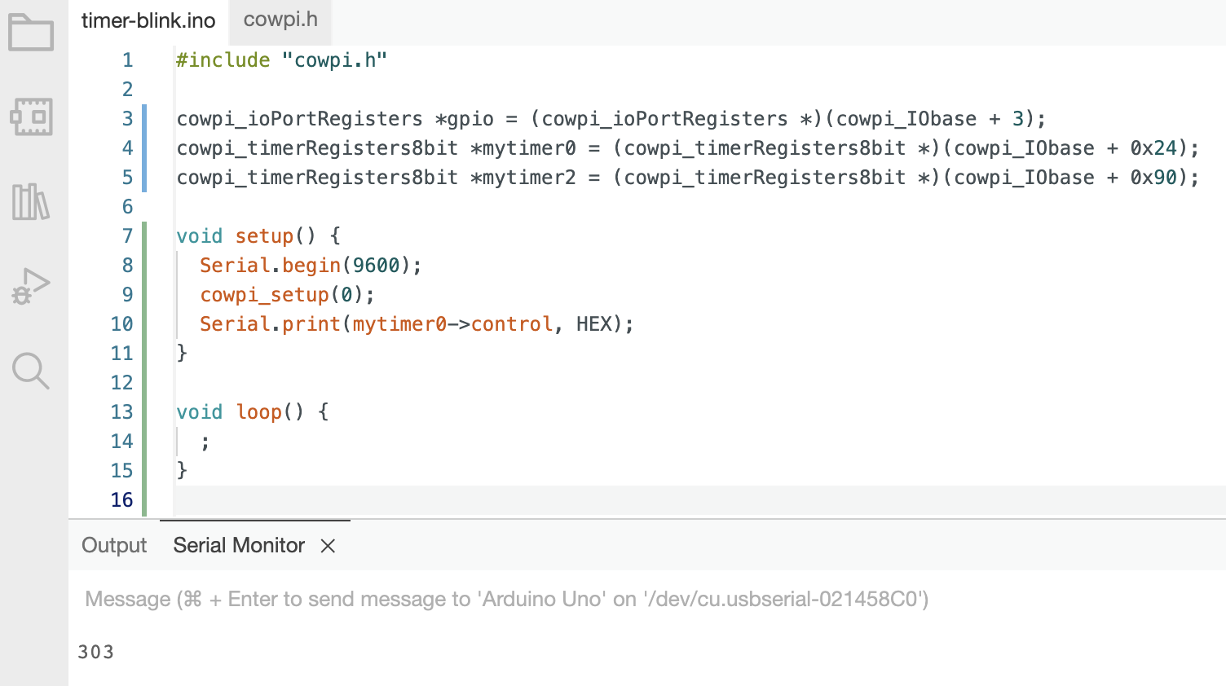
Let’s see what Timer0’s control register holds
Slide by Bohn

Slide 60
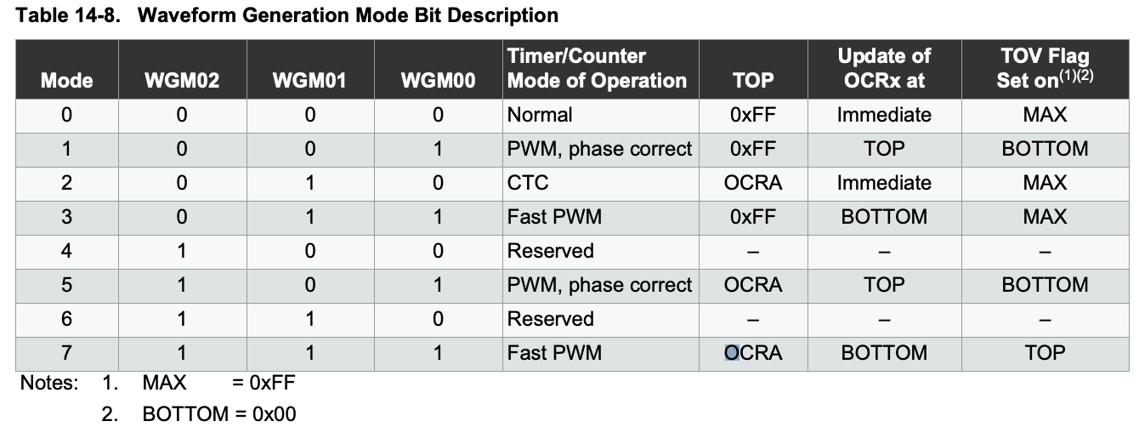
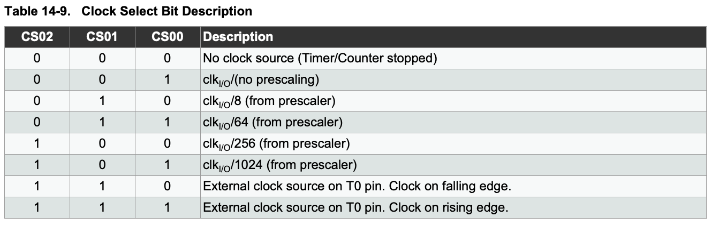
Let’s see what Timer0’s control register holds
0 0 0 0 0 0 1 1
0 0 0 0 0 0 1 1
FOC0A, FOC0B “force output compare” must be zero when in PWM mode
COM0A1, COM0A0, COM0B1, COM0B0 “compare output mode” – normal operation, output compare pin disconnected
Slide by Bohn
ATmega328 Datasheet: https://ww1.microchip.com/downloads/en/DeviceDoc/Atmel-7810-Automotive-Microcontrollers-ATmega328P_Datasheet.pdf

Slide 61
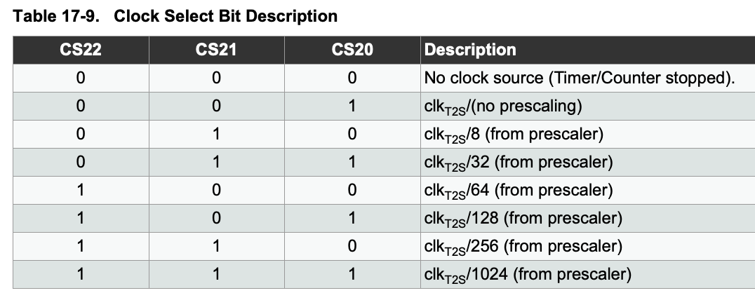
Timer-Blink
uint32_t time = 0, mytime = 0;
uint8_t now = 0, then = 0;
void setup() {
cowpi_setup(0);
mytimer2->control |= 0x0003; // Mode: Fast PWM
mytimer2->control |= 0x0300; // Prescaler: 64
}
Watch out! Timer2 has different prescaler table
Slide by Bohn
ATmega328 Datasheet: https://ww1.microchip.com/downloads/en/DeviceDoc/Atmel-7810-Automotive-Microcontrollers-ATmega328P_Datasheet.pdf

Slide 62
Timer-Blink
void loop() {
time = millis();
then = now;
now = mytimer2->counter;
if (now < then) // overflow?
mytime++;
if (time & 0x0400)
gpio[D8_D13].output |= 0x20;
else
gpio[D8_D13].output &= ~(0x20);
if (mytime & 0x0400)
gpio[D8_D13].output |= 0x10;
else
gpio[D8_D13].output &= ~(0x10);
}
Internal LED
uint32_t time = 0, mytime = 0;
uint8_t now = 0, then = 0;
void setup() {
cowpi_setup(0);
mytimer2->control |= 0x0003; // Mode: Fast PWM
mytimer2->control |= 0x0400; // Prescaler: 64 -- pay attention!
}
External LED
Slide by Bohn

Slide 63
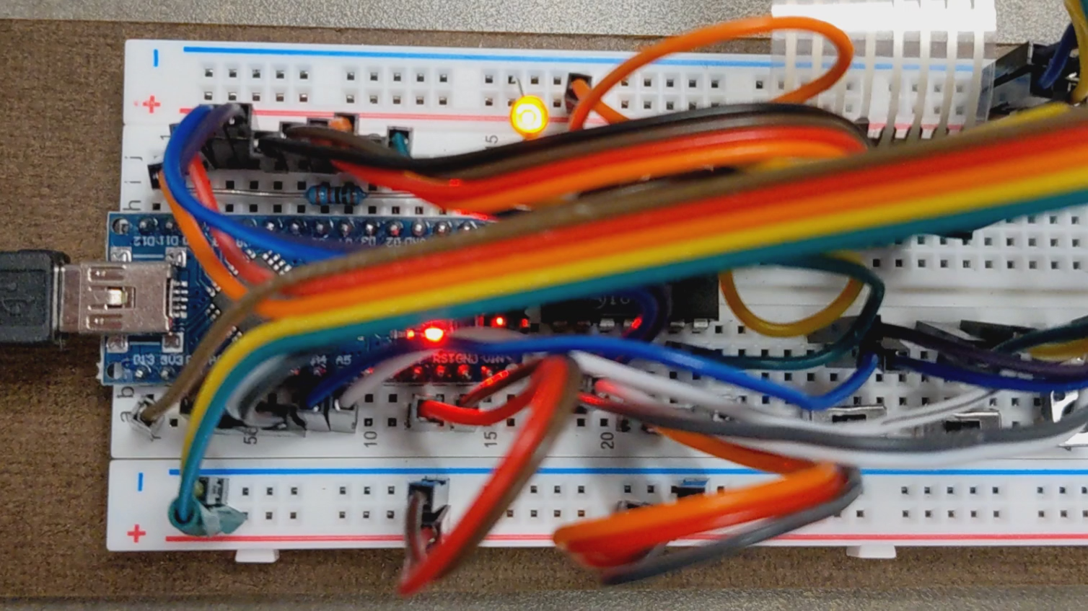
Timer-Blink Demonstration
Slide by Bohn

Slide 64
Exceptional Control Flow
Introduction to Exceptions

Slide 65
Control Flow / Flow of Control
From startup to shutdown, CPU executes sequence of instructions
pushq %rbp
pushq %rbx
subq $8, %rsp
movl %edi, %ebp
movl $0, %ebx
void count_loop_iterations(int max_iterations) {
int i = 0;
int j;
while (i < max_iterations) {
printf("Loop iteration %d.\n", i);
fflush(stdout);
for (j = 0; j < 100000000; j++);
i++;
}
}
Slide by Bohn

Slide 66
Control Flow / Flow of Control
From startup to shutdown, CPU executes sequence of instructions
Sometimes control flow changes due to jump or branch
pushq %rbp
pushq %rbx
subq $8, %rsp
movl %edi, %ebp
movl $0, %ebx
void count_loop_iterations(int max_iterations) {
int i = 0;
int j;
while (i < max_iterations) {
printf("Loop iteration %d.\n", i);
fflush(stdout);
for (j = 0; j < 100000000; j++);
i++;
}
}
jmp …
cmpl $99999999, %eax
jle …
addl $1, %ebx
jmp …
cmpl $99999999, %eax
Slide by Bohn

Slide 67
Control Flow / Flow of Control
From startup to shutdown, CPU executes sequence of instructions
Sometimes control flow changes due to jump or branch
Sometimes control flow changes due to call or return
void count_loop_iterations(int max_iterations) {
int i = 0;
int j;
while (i < max_iterations) {
printf("Loop iteration %d.\n", i);
fflush(stdout);
for (j = 0; j < 100000000; j++);
i++;
}
}
movl %ebx, %esi
movl $.LC0, %edi
movl $0, %eax
call printf
Slide by Bohn
addq $8, %rsp
popq %rbx
popq %rbp
ret

Slide 68
Control Flow / Flow of Control
From startup to shutdown, CPU executes sequence of instructions
Sometimes control flow changes due to jump or branch
Sometimes control flow changes due to call or return
Jump/Branch/Call/Return introduce changes due to program state
What about system state?
Data arrives over network
User hits Control-C
Illegal memory access
Slide by Bohn

Slide 69
Exceptional Control Flow
Exceptions
Control flow change due to system event
Implemented with hardware & OS
Context switch
Implemented with hardware timer & OS
Signals
Implemented by OS
Signals may be generated due to exceptions or due to programs raising signals
User-space programs can handle signals
Slide by Bohn

Slide 70

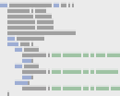
Exception
Control transferred to OS kernel due event
Division by zero
Page fault
I/O request
etc
Control given to exception handler
Each exception type has its own handler
control flow
User Code
exception
Exception Handler
Slide by Bohn
control returns to interrupted instruction or next instruction, or program aborts
Notes:
Kernel – portion of OS that is always present in memory

Slide 71
Exception Table / Interrupt Vector Table
Exception type has unique exception number
Exception number used to index exception table
aka, interrupt vector table
Exception table stores exception handler addresses
Exception Handler 0
Exception Handler 1
2
…
n-1
0
1
Exception Handler 2
Slide by Bohn
Exception Table
︙
Exception Handler n-1

Slide 72
Interrupts / Asynchronous Exceptions
Caused by events external to processor
Unpredictable timing – not caused by code being executed
Examples
Timer
Arrival of data over network
Keypress
Handler returns control to next instruction
Slide by Bohn

Slide 73
Synchronous Exceptions
Triggered by instruction being executed
Trap
Intentional exception
Examples: system call, breakpoint trap
Handler returns control to next instruction
Slide by Bohn

Slide 74
System Call
syscall assembly instruction
System call number in %rax
Arguments in %rdi, %rsi, %rdx, %r10, %r8, %r9
Return value in %rax
System call numbers found in /usr/include/asm/unistd_64.h
Slide by Bohn

Slide 75
System Call Examples
#include <stdio.h>
#include <unistd.h>
int main(int argc, char *argv[]) {
write(1, "Before fork.\n", 13);
int pid = 0;
fork();
pid = getpid();
printf("PID = %d\n", pid);
}
.LC0:
.string "Before fork.\n"
.LC1:
.string "PID = %d\n"
main:
subq $8, %rsp
movl $13, %edx
movl $.LC0, %esi
movl $1, %edi
call write
call fork
call getpid
movl %eax, %esi
movl $.LC1, %edi
movl $0, %eax
call printf
movl $0, %eax
addq $8, %rsp
ret
.LC0:
.string "Before fork.\n"
.LC1:
.string "PID = %d\n"
main:
subq $8, %rsp
movq $1, %rdi
movq $.LC0, %rsi
movq $13, %rdx
movq $1, %rax # syscall number for write
syscall
movq $57, %rax # syscall number for fork
syscall
movl %eax, %esi
movl $.LC1, %edi
movl $0, %eax
call printf
movl $0, %eax
addq $8, %rsp
ret
Slide by Bohn
Notes:
I used printf at the end because converting integer into string would’ve cluttered the code.
The edits made here bring the system calls to the forefront. The library functions in the original code make system calls.

Slide 76
Synchronous Exceptions
Triggered by instruction being executed
Trap
Intentional exception
Examples: system call, breakpoint trap
Handler returns control to next instruction
Fault
Unintentional Exception
Possibly recoverable
Recoverable example: page fault
Handler returns control to current instruction
Unrecoverable example: segmentation fault
Handler aborts process
Slide by Bohn

Slide 77
Page Fault
Attempt to access a memory address not resident in physical memory
Must retrieve memory page from disk
int an_array[500];
int main(int argc, char *argv[]) {
an_array[53] = 19;
}
control flow
User Code
Slide by Bohn
page fault
Copy page from disk to physical memory
main:
movl $19, an_array+212(%rip)
movl $0, %eax
ret
control returns to interrupted instruction

Slide 78
Segmentation Fault
Attempt to write to read-only memory or to access outside process’s address space
OS signals offending process; if unhandled, process exits abnormally
control flow
User Code
int an_array[500];
int main(int argc, char *argv[]) {
an_array[5300] = 19;
}
Detect invalid address
Slide by Bohn
page fault
segmentation fault
send SIGSEGV to process

Slide 79
Synchronous Exceptions
Triggered by instruction being executed
Trap
Intentional exception
Examples: system call, breakpoint trap
Handler returns control to next instruction
Abort
Unintentional exception
Unrecoverable
Example: illegal instruction
Handler aborts process
Fault
Unintentional Exception
Possibly recoverable
Recoverable example: page fault
Handler returns control to current instruction
Unrecoverable example: segmentation fault
Handler aborts process
Slide by Bohn
Notes:
We are not going to demonstrate an abort

Slide 80
Exceptional Control Flow
Handling Interrupts

Slide 81
What’s the output?
int main( void ) {
…
count_loop_iterations(200);
int *pointer;
pointer = 0;
printf("%d", *pointer);
return 0;
}
void count_loop_iterations(int max_iterations) {
int i = 0;
int j;
while (i < max_iterations) {
printf("Loop iteration %d.\n", i);
fflush(stdout);
for (j = 0; j < 100000000; j++);
i++;
}
}
Slide by Bohn

Slide 82
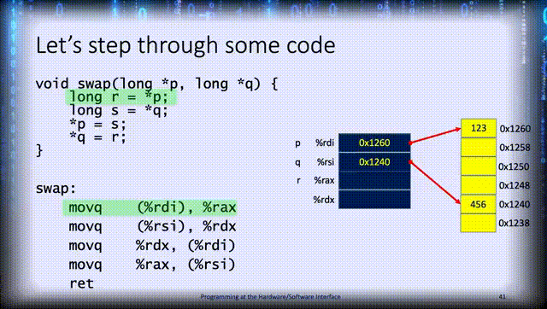
Imagine that you’re a process
You’re minding your own business
running a simple, mild-mannered program
moving data around
updating registers and memory
when suddenly, for no apparent reason
Slide by Bohn
Notes:
Let this slide build and advance on its own

Slide 83

Imagine that you’re a process
You’re minding your own business
running a simple, mild-mannered program
moving data around
updating registers and memory
when suddenly, for no apparent reason
a timer interrupt occurs!
Slide by Bohn
Notes:
Manually advance this slide

Slide 84
Imagine that you’re a process
You’re minding your own business
running a simple, mild-mannered program
moving data around
updating registers and memory
when suddenly, for no apparent reason
a timer interrupt occurs!
The interrupt is handled
control flow
User Code
timer interrupt
Exception Handler
Slide by Bohn
Notes:
Manually advance this slide

Slide 85

Imagine that you’re a process
You’re minding your own business
running a simple, mild-mannered program
moving data around
updating registers and memory
when suddenly, for no apparent reason
a timer interrupt occurs!
The interrupt is handled
and our program resumes where it left off
Slide by Bohn
Notes:
Let this slide advance and build on its own

Slide 86

Imagine that you’re a process
You’re minding your own business
running a simple, mild-mannered program
moving data around
updating registers and memory
when suddenly, for no apparent reason
a timer interrupt occurs!
The interrupt is handled
and our program resumes where it left off
as though nothing had happened
Slide by Bohn
Notes:
Scenario concludes

Slide 87
What’s really the output?
int main( void ) {
…
count_loop_iterations(200);
int *pointer;
pointer = 0;
printf("%d", *pointer);
return 0;
}
void count_loop_iterations(int max_iterations) {
int i = 0;
int j;
while (i < max_iterations) {
printf("Loop iteration %d.\n", i);
fflush(stdout);
for (j = 0; j < 100000000; j++);
i++;
}
}
Slide by Bohn

Slide 88

But… how? What’s causing the extra output?
void set_timer(int seconds) {
timer.it_value.tv_sec = seconds;
timer.it_value.tv_usec = 0;
timer.it_interval.tv_sec = seconds;
timer.it_interval.tv_usec = 0;
setitimer(ITIMER_VIRTUAL, &timer, NULL);
}
void alarm_handler(int signal) {
if (signal == 26)
printf(" **** Interrupted by Signal %d (SIGVTALRM) ****\n", signal);
else if (signal == 2)
printf(" **** Interrupted by Signal %d (SIGINT) ****\n", signal);
else
printf(" **** Interrupted by Signal %d (OTHER) ****\n", signal);
}
void memory_access_handler( int signal ) {
printf("You tried to access memory you shouldn’t. Naughty, naughty!\n");
exit(1);
}
int main( void ) {
set_timer(1);
sigset(SIGVTALRM, alarm_handler);
sigset(SIGINT, alarm_handler);
sigset(SIGSEGV, memory_access_handler);
count_loop_iterations(200);
int *pointer;
pointer = 0;
printf("%d", *pointer);
return 0;
}
Slide by Bohn
Notes:
Let this slide build on its own.
Discussion: set a timer, register signal handlers
Used one signal handler for SIGVTALRM and SIGINT; used another for SIGSEGV

Slide 89
POSIX Signals
SIGNAL NAME NUMBER DESCRIPTION
SIGHUP 1 Hangup
SIGINT 2 Terminal interrupt
SIGQUIT 3 Terminal quit
SIGILL 4 Illegal instruction
SIGTRAP 5 Trace trap
SIGIOT 6 IOT Trap
SIGBUS 7 BUS error
SIGFPE 8 Floating point exception
SIGKILL 9 Kill (can't be caught or ignored)
SIGUSR1 10 User defined signal 1
SIGSEGV 11 Invalid memory segment access
SIGUSR2 12 User defined signal 2
SIGPIPE 13 Write on a pipe with no reader, Broken pipe
SIGALRM 14 Alarm clock
SIGTERM 15 Termination
SIGNAL NAME NUMBER DESCRIPTION
SIGSTKFLT 16 Stack fault
SIGCHLD 17 Child process has stopped or exited, changed
SIGCONT 18 Continue executing, if stopped
SIGSTOP 19 Stop executing (can't be caught or ignored)
SIGTSTP 20 Terminal stop signal
SIGTTIN 21 Background process trying to read, from TTY
SIGTTOU 22 Background process trying to write, to TTY
SIGURG 23 Urgent condition on socket
SIGXCPU 24 CPU limit exceeded
SIGXFSZ 25 File size limit exceeded
SIGVTALRM 26 Virtual alarm clock
SIGPROF 27 Profiling alarm clock
SIGWINCH 28 Window size change
SIGIO 29 I/O now possible
SIGPWR 30 Power failure restart
Slide by Bohn

Slide 90
But… how? What calls the other code?
control flow
Exception occurs
User Code
Signal sent to process
Signal handler (default or custom) executes
Control resumes unless signal handler terminated process
Exception Handler
Slide by Bohn
Signal
Handler
(user code)

Slide 91


But… how? Why isn’t count_loop_iterations affected?
control flow
User Code
exception
Kernel
Code
Slide by Bohn
https://git.kernel.org/pub/scm/linux/kernel/git/torvalds/linux.git/tree/arch/x86/entry/entry_64.S
Notes:
The kernel saves the interrupted process’ context, and restores the context when finished.

Slide 92
Well, that’s cool
Yes, yes it is
What about the Cow Pi?
Slide by Bohn

Slide 94
Raspberry Pi Pico Interrupts
We can poll the timer
We can handle timer interrupts
Timer interrupts are generally more useful than polling the timer
Exact duration vs approximate duration
Can we write code to blink the LEDs using timer interrupts?
Slide by Bohn

Slide 95
Interrupt “Blink”
void loop() { /* do stuff, or nothing */ }
void setup() {
static mbed::Ticker ticker;
ticker.attach(blink, std::chrono::seconds(1));
}
void blink() { // ISR, aka interrupt handler
static bool led_state = false;
led_state = !led_state;
if (led_state) { cowpi_illuminate_internal_led(); }
else { cowpi_deluminate_internal_led(); }
}
Slide by Bohn
Notes:
ISR is common term: Interrupt Service Routine
Keep ISRs short! (not necessarily 1-line, but short)
Often, the ISR will set some variable used by the “do stuff” code

Slide 96
Interrupt “Blink” Demonstration
Slide by Bohn

Slide 97
Arduino Nano Interrupts
We can poll the timer
We can handle timer interrupts
Timer interrupts are more useful than polling the timer
Pseudo-real-time clock updates due to timer overflow interrupt from Timer0
Can we write code to track “milliseconds” using timer interrupts?
Slide by Bohn

Slide 98

Timer-Blink (Interrupt Version)
uint32_t time = 0;
uint32_t mytime = 0;
uint8_t *timer_interrupt_mask = (uint8_t *)(0x6E);
void setup() {
cowpi_setup(0);
timer_interrupt_mask[0] |= 0x02; // enable "compare match A" interrupt
mytimer0->compareA = 0x80; // compare to 0x80 (halfway between overflows)
}
Slide by Bohn
ATmega328 Datasheet: https://ww1.microchip.com/downloads/en/DeviceDoc/Atmel-7810-Automotive-Microcontrollers-ATmega328P_Datasheet.pdf
Notes:
We’re making mytime “volatile” since it’ll be updated in one function and read in another – so we don’t want it optimized into a register

Slide 99
Timer-Blink (Interrupt Version)
ISR() and vectors provided by gcc
ISR() – creates interrupt handler for specified interrupt vector
ISR(TIMER0_COMPA_vect) {
mytime++;
}
void loop() {
time = millis();
if (time & 0x0400)
gpio[D8_D13].output |= 0x20;
else
gpio[D8_D13].output &= ~(0x20);
if (mytime & 0x0400)
gpio[D8_D13].output |= 0x10;
else
gpio[D8_D13].output &= ~(0x10);
}
Slide by Bohn
TIMER0_COMPA_vect “TimerCounter0 Compare Match A”
avr-libc avr/interrupt.h: https://www.nongnu.org/avr-libc/user-manual/group__avr__interrupts.html
Notes:
ISR is common term: Interrupt Service Routine
Keep ISRs short! (not necessarily 1-line, but short)

Slide 100

Arduino Nano Interrupts
Can we write code to interrupt every 1.0 second?
Yes, by resetting counter earlier than natural overflow
Set prescaler to 1024: $\frac{16,000,000\frac{cycles}{sec}}{1024\frac{cycles}{beat} × 1\frac{interrupt}{sec}}=15,625\frac{beats}{interrupt}$
Indistinguishable on human scale, but set compare value to 15,625-1 = 15,624
The first beat is when counter is 0; the second beat is when counter is 1, etc
Too great for 8-bit timer
But we have a 16-bit timer
Slide by Bohn

Slide 101



One-Second Interrupt Blink
typedef struct {
uint32_t control;
uint16_t counter;
uint16_t capture;
uint16_t compareA;
uint16_t compareB;
} cowpi_timer16bit_t;
Volatile struct timer_registers_16bit *mytimer1 = (struct timer_registers_16bit *)(0x80);
Slide by Bohn
ATmega328 Datasheet: https://ww1.microchip.com/downloads/en/DeviceDoc/Atmel-7810-Automotive-Microcontrollers-ATmega328P_Datasheet.pdf

Slide 102
One-Second Interrupt Blink
void setup() {
cowpi_setup(0);
// Prescaler: 1024
mytimer1->control = 0x500;
// clear timer on compare match
mytimer1->control |= 0x800;
// interrupt (and clear counter) // every 15,625 beats
mytimer1->counter = 0;
mytimer1->compareA = 15624;
timer_interrupt_mask[1] |= 0x02;
}
ISR(TIMER1_COMPA_vect) {
gpio[D8_D13].output ^= 0x10;
}
void loop() {
time = millis();
if (time & 0x0400)
gpio[D8_D13].output |= 0x20;
else
gpio[D8_D13].output &= ~(0x20);
}
Slide by Bohn

Slide 103

One-Second Interrupt Blink Demonstration
Slide by Bohn
Notes:
The external LED is consistently about a half-tick off from the watch’s second hand.
The internal LED starts off similarly out-of-phase, drops into phase with the second hand, drops out, and drops in again.

Slide 104
Raspberry Pi Pico Interrupts
We can poll the timer
We can handle timer interrupts
We can poll the pins
We can handle interrupts from the pins
Slide by Bohn

Slide 105

You Could Configure Interrupts by Manipulating Registers…
Slide by Bohn

Slide 106
You Could Configure Interrupts by Manipulating Registers…
Slide by Bohn

Slide 107
…Or, Go to Higher Level of Abstraction
Arduino Core
mbed OS
CowPi Library
Slide by Bohn

Slide 108
Arduino Core External Interrupt Functions
attachInterrupt(pin, isr_function, mode)
detachInterrupt(pin)
CHANGE, RISING, FALLING, or LOW
pin number
pin number
Function to handle interrupt
Slide by Bohn
https://www.arduino.cc/reference/en/
Notes:
Some microcontrollers need `digitalPinToInterrupt(pin)` instead of `pin`

Slide 109
mbed OS InterruptIn Class
static mbed::InterruptIn variable_name((PinName)pin, pull_mode)
variable_name.rise(isr_function)
variable_name.rise(isr_function)
variable_name.disable_irq()
pin number
PullUp, PullDown, or PullNone
Slide by Bohn
Function to handle interrupt
https://os.mbed.com/docs/mbed-os/v6.16/mbed-os-api-doxy/classmbed_1_1_interrupt_in.html
Notes:
Only works in C++ code
Need to cast pin number to type PinName
If we don’t specify PullUp, PullDown, or PullNone then it will default to PullDefault, overriding the CowPi configuration. (I think PullDefault is PullNone, but I need to double-check.)
IRQ = Interrupt Request

Slide 110
CowPi Pin Change Interrupt Functions
cowpi_register_pin_ISR(interrupt_mask, isr_function)
cowpi_deregister_pin_ISR(interrupt_mask)
Bit vector specifying which pin(s) are being registered
Bit vector specifying which pin(s) are being registered
Function to handle interrupt
Slide by Bohn
https://cow-pi.readthedocs.io/en/latest/CowPi/interrupts.html
https://cow-pi.readthedocs.io/en/latest/microcontroller.html#registering-pin-change-interrupt-handlers-using-cowpi-register-pin-isr

Slide 111
CowPi Pin Change Interrupt Functions
cowpi_register_pin_ISR(1L << pin_number, isr_function)
cowpi_register_pin_ISR( (1L << first_pin_number) | (1L << second_pin_number) | (1L << et_cetera), isr_function)
Slide by Bohn
https://cow-pi.readthedocs.io/en/latest/CowPi/interrupts.html
https://cow-pi.readthedocs.io/en/latest/microcontroller.html#registering-pin-change-interrupt-handlers-using-cowpi-register-pin-isr
Notes:
You can succinctly register multiple pins for the same ISR

Slide 112
Arduino Nano Interrupts
We can poll the timer
We can handle timer interrupts
We can poll the pins
We can handle interrupts from the pins
Slide by Bohn

Slide 113
ATmega368P Has Two Types of Pin Interrupts
typedef struct {
uint8_t pci_flags;
uint8_t ei_flags;
uint8_t ei_mask;
uint8_t __DO_NOT_TOUCH_1__[0x2A];
uint8_t pci_control;
uint8_t ei_control;
uint8_t __DO_NOT_TOUCH_2__;
uint8_t pci_mask[3];
} cowpi_pininterrupt_t;
Pin Change Interrupt
Detect logic level change on pins by I/O port (B,C,D)
If interrupt triggered, need to compare pin register to last known value to determine which had the change
External Interrupt
Only available for 2 pins
Can be configured to trigger on any change, rising/falling edge, or logic level
Slide by Bohn

Slide 114
Going to Higher Level of Abstraction
Normal Arduino:
Pin Change Interrupts must be handled by setting registers and using avr-libc macros
External Interrupts may be handled by setting registers and using avr-libc macros
Arduino Core provides abstraction for external interrupts
Programmer-friendlier interface
Allows more-portable code
Slide by Bohn

Slide 115
Arduino Core External Interrupt Functions
attachInterrupt(digitalPinToInterrupt(pin), isr_function, mode)
detachInterrupt(digitalPinToInterrupt(pin))
Converts pin number to interrupt number (optional but recommended)
CHANGE, RISING, FALLING, or LOW
Converts pin number to interrupt number (optional but recommended)
pin number (2 or 3)
pin number (2 or 3)
Function to handle interrupt
Slide by Bohn
https://www.arduino.cc/reference/en/

Slide 116

Narcoleptic Blinker
LED blinks
Microcontroller idles after 5 seconds
Wakes on button press
Either button
Slide by Bohn
Cow Pi pushbuttons
avr-libc avr/sleep.h: https://www.nongnu.org/avr-libc/user-manual/group__avr__sleep.html
ATmega328 Datasheet: https://ww1.microchip.com/downloads/en/DeviceDoc/Atmel-7810-Automotive-Microcontrollers-ATmega328P_Datasheet.pdf
Notes:
In hindsight, we would’ve had more sleep options if we used a 74LS21 quad-input AND instead of a 74LS20 quad-input NAND. We can fix that in the future.

Slide 117
Narcoleptic Blinker
if (millis() & 0x100) {
digitalWrite(12, HIGH);
digitalWrite(13, LOW);
if (cycled) {
cycled = false;
count++;
}
} else {
digitalWrite(12, LOW);
digitalWrite(13, HIGH);
cycled = true;
}
if (count == 10) {
count = 0;
go_to_sleep();
}
}
#include <avr/sleep.h>
void go_to_sleep();
void waken();
void setup() {
cowpi_stdio_setup(9600);
cowpi_setup(0);
}
void loop() {
static char count = 0;
static bool cycled = true;
Slide by Bohn

Slide 118
Narcoleptic Blinker
void go_to_sleep() {
printf("sleep\n");
digitalWrite(12, LOW); // LED stays lit when CPU sleeps, so turn it off
timer_interrupt_mask[0] &= 0xFE; // Timer0 interrupt wakes CPU from IDLE, so disable it
sleep_enable();
set_sleep_mode(SLEEP_MODE_IDLE);
attachInterrupt(digitalPinToInterrupt(2), waken, FALLING);
sleep_cpu();
}
void waken() {
detachInterrupt(digitalPinToInterrupt(2));
sleep_disable();
timer_interrupt_mask[0] |= 0x01; // Re-enable Timer0 overflow interrupt
digitalWrite(12, HIGH); // Turn LED back on
printf("\tawake\n");
}
Slide by Bohn

Slide 119

Narcoleptic Blinker Demonstration
Slide by Bohn
Notes:
There must be another external interrupt that sneaks in sometimes (switch bounce?) that causes the CPU to reawaken immediately after going to sleep sometimes. Any other interrupt would’ve left Timer0 interrupts disabled.

Slide 120
Going to Higher Level of Abstraction
Normal Arduino:
Pin Change Interrupts must be handled by setting registers and using avr-libc macros
External Interrupts may be handled by setting registers and using avr-libc macros
Arduino Core provides abstraction for external interrupts
Programmer-friendlier interface
Allows more-portable code
CowPi library provides abstraction for pin change interrupts
Hides some of the normal limitations of pin change interrupts
Slide by Bohn

Slide 121
CowPi Pin Change Interrupt Functions
cowpi_register_pin_ISR(interrupt_mask, isr_function)
cowpi_deregister_pin_ISR(interrupt_mask)
Bit vector specifying which pin(s) are being registered
Bit vector specifying which pin(s) are being registered
Function to handle interrupt
Slide by Bohn
https://cow-pi.readthedocs.io/en/latest/CowPi/interrupts.html
https://cow-pi.readthedocs.io/en/latest/microcontroller.html#registering-pin-change-interrupt-handlers-using-cowpi-register-pin-isr

Slide 122
CowPi Pin Change Interrupt Functions
cowpi_register_pin_ISR(1L << pin_number, isr_function)
cowpi_register_pin_ISR( (1L << first_pin_number) | (1L << second_pin_number) | (1L << et_cetera), isr_function)
Slide by Bohn
https://cow-pi.readthedocs.io/en/latest/CowPi/interrupts.html
https://cow-pi.readthedocs.io/en/latest/microcontroller.html#registering-pin-change-interrupt-handlers-using-cowpi-register-pin-isr

Slide 123
Exceptional Control Flow
Processes

Slide 124
Processes
Process Context
Memory Space
Stack
Data Registers
Instance of a running program
Not the program itself
Instance of program, resident in memory, executing (or waiting to execute)
Logical flow of control
Appears to have exclusive use of processor
Kernel uses context switching to provide this illusion
Private address space
Appears to have exclusive use of main memory
Kernel uses virtual memory to provide this illusion
Condition Codes
Heap
Program Counter
Stack Pointer
Kernel Context
NOT ALWAYS ILLUSIONS
Sometimes processes really do have (almost) exclusive use of processor and memory
Executable code
Header information and constants
Slide by Bohn
Notes:
Examples of situations in which exclusive access to resources isn’t illusionary: microcontrollers, and microprocessors running single-tasking operating systems (e.g., CP/M, MS-DOS). Even then, some context switching is necessary to handle interrupts.

Slide 125





Illusion of exclusive use of CPU & memory
Slide by Bohn

Slide 126

Multiprocessing Example
393 processes, 2 of which are active
Identified by Process ID (PID)
Slide by Bohn

Slide 127



Illusion of Multiprocessing
Many processes run simultaneously, each apparently with its own processor
Email client, chat client, terminal windows, web browsers…
…
Slide by Bohn
CPU
CPU
CPU
CPU
CPU

Slide 128
Reality of Multiprocessing
One processor executes many concurrent processes
Interleaves process executions – multitasking
Each has its own virtual memory address space – shares physical memory
Non-executing processes have context saved in memory
Physical Memory
Slide by Bohn
…
saved
registers
saved
registers
saved
registers
saved
registers
registers
CPU

Slide 129
Context Switch
Outgoing process’s registers, stack pointer, program counter, etc saved to memory
New process selected for execution
Incoming process’s registers & stack pointer restored from memory
Physical Memory
Slide by Bohn
…
saved
registers
saved
registers
saved
registers
saved
registers
registers
saved
registers
CPU

Slide 130
Multicore Processors
Multiple processor cores on single die
Share physical memory
Each can execute a different process
Physical Memory
Slide by Bohn
…
saved
registers
saved
registers
saved
registers
registers
registers
Core 0
Core 1

Slide 131



Recall: Context Switch
Process 1
Waiting
Executing
Processor Core
Executing
Waiting
Process 2
OS Scheduler:
Pauses executing process
Saves executing process’s context to memory
Registers, stack pointer, program counter, etc.
Selects waiting process to be scheduled for execution
Restores scheduled process’s context from memory
Allows concurrency even on computer with one single-core processor
Context Switch
Context Switch
Slide by Bohn

Slide 132

Context Switch
Similar to exception handling
Exception handler returns control to same process (or terminate it)
Context switch returns control to different process
Illusion of never having been interrupted is preserved by saving/restoring process context
control flow
User Code
User Code
context switch
Kernel Code
context switch
Slide by Bohn

Slide 133

Key Ideas
Input/Output registers often mapped to memory address space
Not actually part of main memory
Polling: continually checking registers’ contents to determine if action is necessary
Interrupt: asynchronous exception identifies need for action
Fault: exception caused by program’s instruction identifies need for action
Signal: OS construct fired by exception handler or by another process
Context switches look very much like interrupts
Preserves control flow illusion
Slide by Bohn

